Slide 1

Notes:
This course introduces learners to job and career opportunities in highway construction.
High worker demand has led employers to create training programs focused on short-term learning, which can lead to long-term employment. Good jobs are available now. New government funding has boosted the demand for workers.

Slide 2

Highway Construction industry
We are excited to share with you today an overview of the career opportunities available in the construction industry and the high demand for workers like you!
Thank you for joining us today.
Notes:
Best Construction Jobs | Best Jobs Rankings | US News Careers
https://money.usnews.com/careers/best-jobs/rankings/best-construction-jobs
The highway construction industry enables people to pursue a wide range of career opportunities. U.S. News & World Report has rated it among the best jobs based on analyzed data about salary, unemployment rates, and stress. The road construction industry offers a great opportunity – a career that provides great pay, benefits, and steady work.
Employers pay laborers above-average salaries with good benefits. In 2020, the median pay was $20.67 /hour for construction laborers according to the U.S. Bureau of Labor Statistics.
Link or reference Construction Laborers (bls.gov)

Slide 3
Course Objectives
Upon completing this course, you will be able to:
Access career pathways
Recognize high-demand job needs
Understand available training and education programs
Appreciate general expectations and requirements of employability in construction related positions
Notes:
Upon completing this course, you will be able to:
Assess career pathways
Recognize high-demand job needs
Understand available training and education programs
Appreciate general expectations and requirements of employability in construction related positions

Slide 4
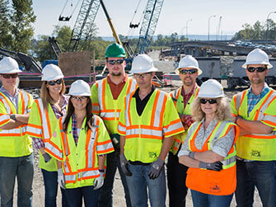
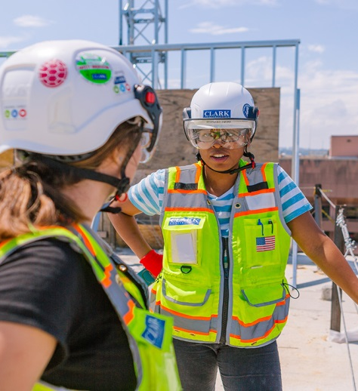
Good paying careers are available now!
This Session will cover the following items:
Open Positions
Employment Expectations
Safety
Training Programs
On the Job Expectations
Notes:
Optional Slide to use if hosting a career fair at the same time.
Today we will focus on career opportunities in the industry and the skills it takes to be successful.
Contractors will share information on how or why they are in the industry and the career opportunities that are available.
In addition, we have a Career Fair that will provide you with an opportunity to visit with contractors that have open positions. Construction season is right around the corner and we need you.

Slide 5
Module 1
Highway Construction Industry
Notes:
This module provides an overview of worker shortages in the highway construction industry. It also discusses long-term career opportunities, with above average earning potential.

Slide 6
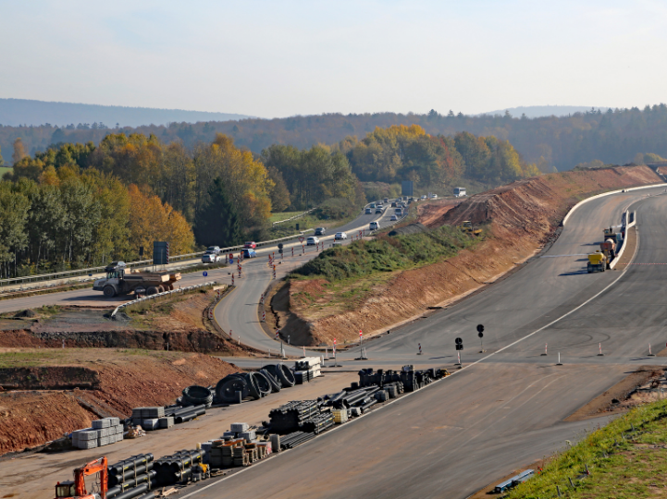
What is the Highway Construction Industry?
This industry group is primarily engaged in the construction of highways, streets, roads, airport runways, public sidewalks, or bridges. Work performed may include new work, reconstruction, rehabilitation, and repairs.
The Economic Impact of Construction in the U.S. and South Dakota.
Notes:
Click link view statistics about the Economic Impact of Construction in the United States and South Dakota. SD.pdf (agc.org)
These statistics can be referenced at different points throughout the presentation.

Slide 7
Government Funding and Programs support the Highway Industry
The Investing in a New Vision for the Environment and Surface Transportation in America Act (INVEST in America)
  This act:
    Delivers better roads and bridges
    Modernizes infrastructure
    Measures state-by-state greenhouse gas emissions
    Increases funding for development of charging stations and other alternative fueling options for electric and zero-emissions vehicles
    Addresses pedestrian and bicyclist routes
    Funds green materials research
  The U.S. economy’s strength is directly linked to highway construction.
Notes:
The Investing in a New Vision for the Environment and Surface Transportation in America (INVEST in America) Act is a 5-year, $494 billion investment into infrastructure repair and funding new, transformative projects that will create millions of jobs and support American manufacturing and ingenuity, while reducing carbon pollution, dramatically improving safety, and spurring economic activity. It’s investing in infrastructure that is smarter, safer, and made to last. This act:
Delivers better roads and bridges by repairing broken or outdated infrastructure, including 47,000 structurally deficient bridges, before building new highway capacity.
Modernizes infrastructure with new funding, addressing impactful projects for local, regional, and national transportation networks.
Measures state-by-state greenhouse gas emissions, with incentives for best performers in carbon pollution reduction, and a new program to fund resilient infrastructure that can withstand the impacts of climate change.
Dramatically increases funding for development of charging stations and other alternative fueling options for electric and zero-emissions vehicles.
Addresses rising rates of pedestrian and bicyclist deaths by requiring States with the highest rates to set aside funding to tackle the problem, codifies and expands eligibility for safe routes to school, provides funding to develop active transportation networks, and strengthens emphasis on high-risk rural roads.
Doubles funding for technology deployment to increase innovation and creates new program to fund green materials research and to deploy green construction materials and practices to create smarter, more efficient transportation systems.
The U.S. economy’s strength is directly linked to highway construction.

Slide 8
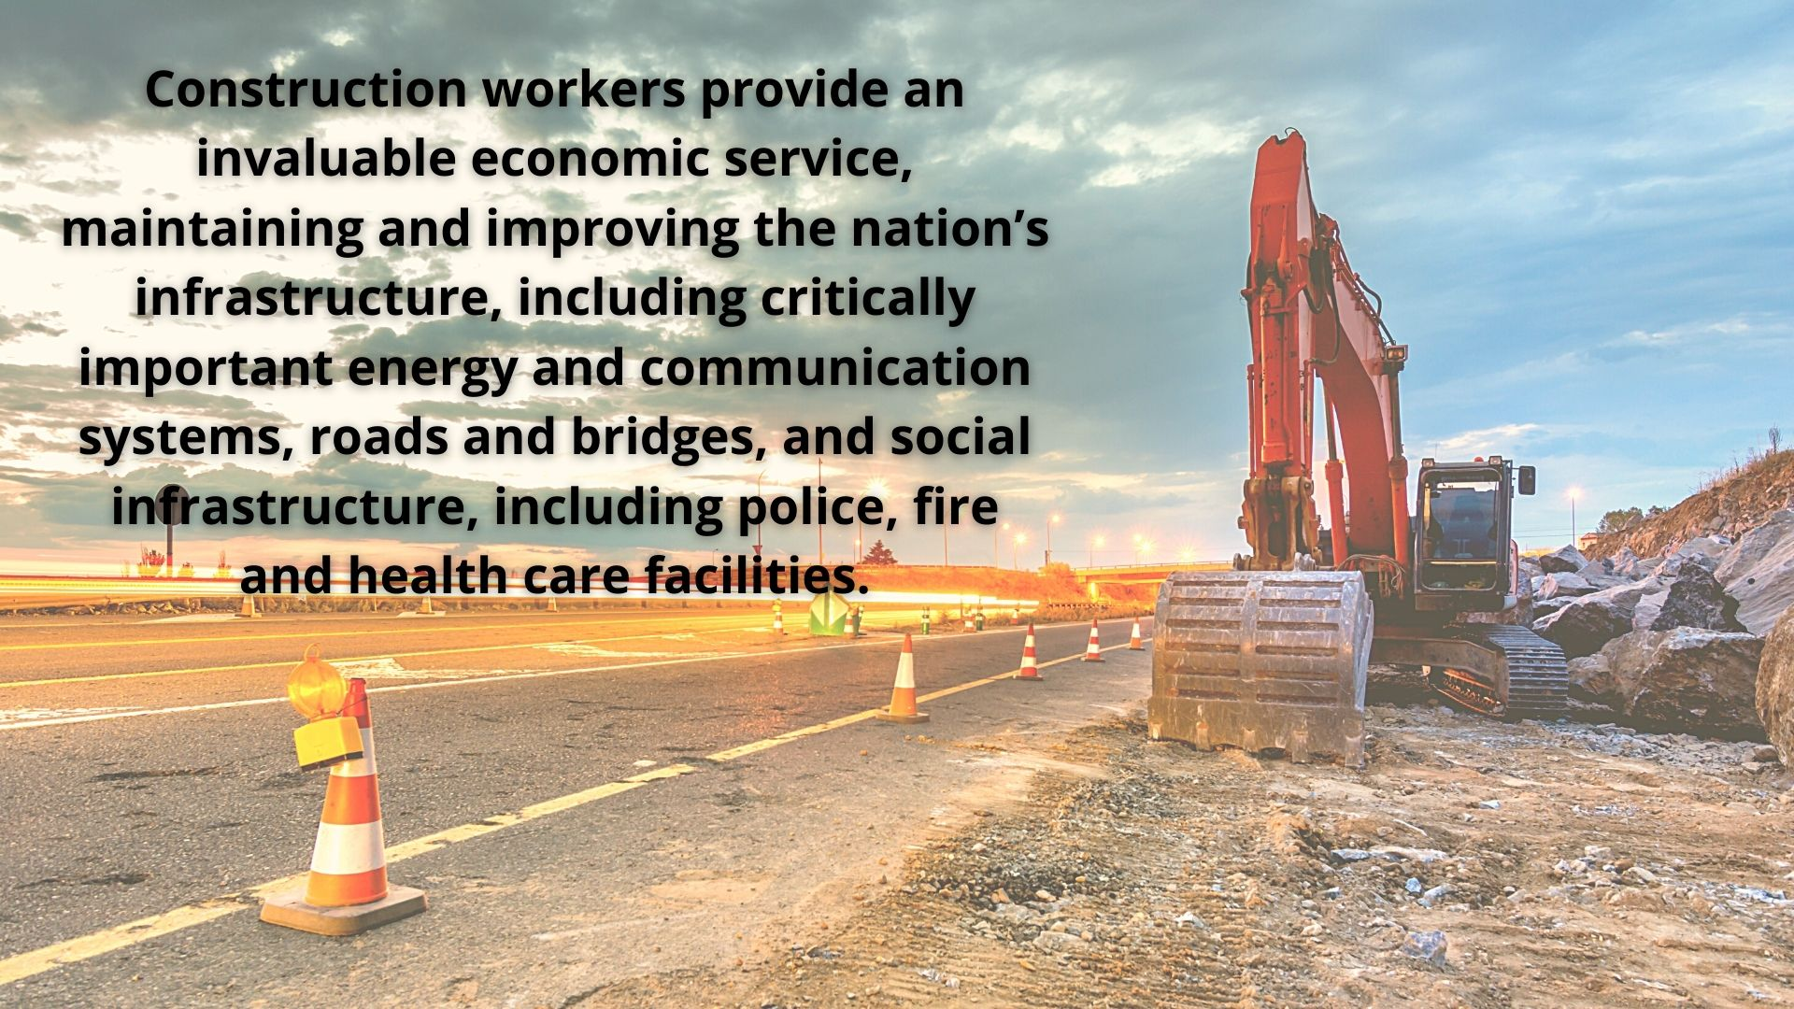
Notes:
Highway construction projects build and maintain the infrastructure that is critical to keep the United States economically strong.
Projects also provide jobs and inject funds into local and regional communities.
Growth has been strong in recent years, with construction spending at all-time high.

Slide 9
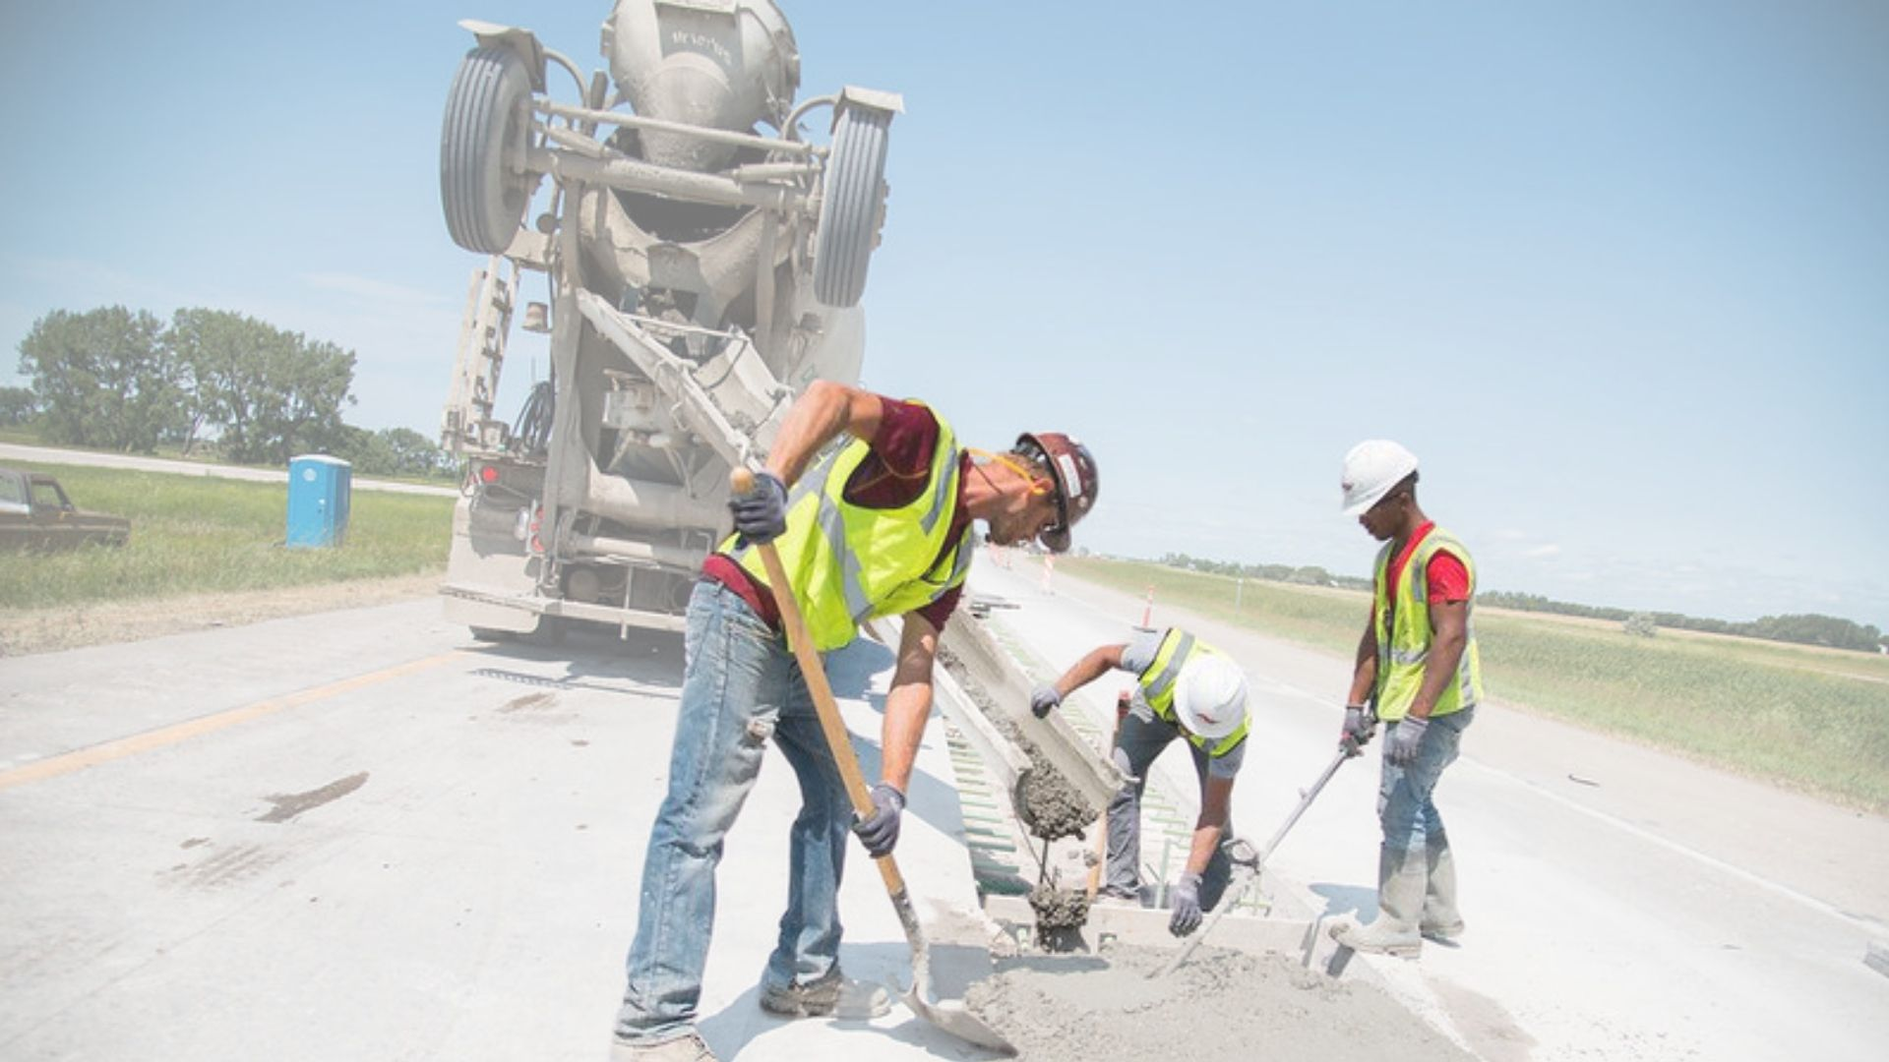
Why work in the Highway Construction Industry?
BUILD SOMETHING MEANINGFUL
SALARIES & BENEFITS ARE GENEROUS
WORK IN DIFFERENT PARTS OF THE STATE OR COUNTRY
EXPERIENCE DIFFERENT WORK PROJECTS REGULARLY
The industry is strong
Escape the office environment
Notes:
Highway projects provide meaningful jobs that positively impact society. Transportation projects allow people to connect with nearby communities, reduce congestion and accidents, and improve quality of life for all. Deteriorating highway infrastructure has led to a growing need for workers. As a result, the industry is experiencing major labor shortages.
Careers in the industry offer many benefits to employees including:
• Be involved in meaningful work. Take pride at what you helped build
• Salaries and benefits are generous.
• Opportunity to work in different regions and different parts of the state or country.
o Near or away
o Every job is an adventure.
• Experience different work projects regularly.
• The industry is strong and considered a reliable source of long-term employment.
• Escape the office environment. Get paid for working outside.

Slide 10
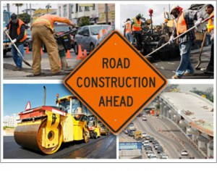
The road construction industry is offering you the opportunity of a lifetime - a lifelong career that provides you with great pay, great benefits and steady work!
GOOD JOBS ARE AVAILABLE NOW
  New funding boosts demand for skilled and unskilled workers
  Over 700 open positions are available in South Dakota
  The need for workers is in high demand and that demand is expected to grow 5% in the next 10 years
Notes:
Contractors are hiring.
In the 2020 AGC – Autodesk Workforce Survey, 60% of firms in the U.S. and 81% of firms in South Dakota had unfilled hourly craft positions.
Employers across the state and nation are seeking to recruit and retain diverse workforces. There are many entry level opportunities available. In addition, employers are especially eager to fill skilled labor positions. Many are willing to provide training to give unskilled laborers an opportunity to become skilled laborers. [teacher note to list jobs available]

Slide 11

Where are the Jobs in the Highway Construction Industry?
Notes:
Opportunities are available throughout South Dakota and the country. Most companies are hiring at all skill levels. In addition, there are a wide variety of jobs.

Slide 12
Module 2
Career Pathways
Notes:
This module provides an overview of career opportunities in highway construction. It addresses jobs that require no, or little, training or experience, for very good pay. It also discusses skilled labor positions, Many of these opportunities can lead to long-term, gainful employment.

Slide 13


What Opportunities are Available?
Many jobs in the highway construction industry require minimal training or experience.
One example: Flagger
Flaggers are typically employed to control the flow of traffic around road construction sites. They erect warning and detour signs, position traffic cones and barricades, and inform the construction crew of any safety hazards.

Slide 14
Sample Job Description: Flagger
Flagger Responsibilities:
Using hand signals and direction signs to direct traffic around road construction sites.
Communicating with other flaggers using hand-held radios to direct two-way traffic onto a single lane.
Informing the construction crew of any traffic issues that may affect their safety.
Appropriately positioning warning and detour signs around construction sites.
Setting up barricades and traffic cones along construction sites to block off certain areas.
Removing all signs, barricades, and traffic cones upon completion of construction work.
Assisting the construction crew in the removal of rubble, debris, and hazardous materials.
Recording the license plate numbers of motorists who neglect to obey traffic signs and directions.
Flagger Requirements:
High school diploma or GED.
Certification through the American Traffic Safety Services Association (ATSSA).
Proven experience working as a flagger.
Sound knowledge of state traffic regulations.
The ability to stand for extended periods.
The ability to work as part of a team.
The ability to work in harsh weather conditions.
Excellent organizational and problem-solving skills.
Exceptional observation skills.
Effective communication skills.
Notes:
XYZ Construction is looking to hire a dedicated and observant flagger to monitor the flow of traffic around road construction sites. Flagger's responsibilities include informing motorists of possible detour routes, reporting disobedient drivers to law enforcement officials, and answering motorists’ questions. You should also be able to direct emergency vehicles safely through construction zones as required.
To be successful as a flagger, you should have excellent communication skills and be able to work effectively as part of a team. Ultimately, a top-notch flagger should demonstrate a sound knowledge of state traffic regulations as well as exceptional observation skills.

Slide 15


SALARIES AND BENEFITS ARE GENEROUS
  Pay is above average with good benefits as you progress
  2019 median pay of $17.31/hour in a variety of jobs
IT'S A CAREER, NOT JUST A JOB
  Work hard, move up, and enjoy the life you want
  No experience necessary
  Opportunities to gain skills
Notes:
The outlook for long-term employment in highway construction is excellent.
employment of construction laborers and helpers is projected to grow 7 percent from 2020 to 2030
The industry has traditionally been one of the fastest growing throughout the United States, and demand will remain strong for the foreseeable future.
There are a variety of positions available throughout South Dakota for entry-level workers.
- Currently, there are over 700 open positions in the construction industry in South Dakota (source: SimplyHired 20 Best construction jobs in South Dakota (Hiring Now!) | SimplyHired)
- Many companies have hiring incentives of $2000 or more
- Hard work and willingness to learn, open doors and allows workers to advance.
- Entry-level jobs can lead to more advanced positions.

Slide 16

Career Opportunities
Examples of Entry-level positions
General Laborer
Flagger
Parts Runner
Truck Driver (with or without CDL)
Generally, there are no specific educational requirements for an entry-level position in the highway construction industry. Employers look for people with skills such as:
Experience working with tools.
Physically able to do the work.
Heavy lifting may be required.
Notes:
Entry-level positions provide a starting point for each trade. These positions teach tips and tricks of the trade that help workers progress. For example, many construction workers start as a laborer. They carry out a wide range of practical tasks to help tradepersons on construction sites. They clean the site on a regular basis using hand tools such as shovels, rakes, and wheelbarrows to remove debris, scraps, and other materials. They might also sweep out certain areas and put supplies in order. They will likely load and unload building materials. A laborer will follow instructions from construction project managers and supervisors.
Experience on the site provides opportunities for increased responsibilities:
Assisting craft workers such as carpenters or electricians with their duties, if needed.
Taking apart or constructing scaffolding, bracing, and other temporary structures for the construction site.
Operating equipment used in construction sites
Digging trenches and backfill holes to prepare for the construction site
Generally, there are no specific educational requirements for an entry-level position in the highway construction industry.
Experience working with tools
Physically able to do the work
Heavy lifting may be required.
The great thing about all the positions here, are that all of them allow you to start learning while you earn a paycheck. You can work your way up and advance from there. If you’re eager to learn, work hard, show up, ask questions, and communicate your desire to keep learning and growing, you can keep working your way up.

Slide 17
Career Opportunities
Skilled positions - examples
Welder
Heavy Equipment Operator, Crane Operator
Concrete Finisher
Apprenticeships
Foreman
Truck Driver (with CDL)
  Specialized Vehicle Drivers/Operators
Notes:
Advanced positions, also known as construction trades, or skilled labor, require training or formal education. They may also require certifications or licensing. Training takes two main forms: apprenticeship and employer-provided programs. In addition, formal education programs relevant to highway construction are typically offered by technical colleges and trade schools. Internships provide additional opportunities throughout South Dakota and the United States. For example, currently the SDDOT is offering internships in: Watertown, Pierre, Yankton, Custer, Huron, Mitchell, Aberdeen, Mobridge, Winner, Rapid City, Brookings, Sioux Falls, Belle Fourche
Trainees learn craftsmanship by working under more experienced journeymen and master craftsmen. Some trades do not have licensing requirements but may require certifications. Some trades have rigorous licensing requirements. Researching certification or licensing requirements for specific trades is recommended.
Skilled labor positions include:
Welder – add definitions of what the position is, what they do, skills included
Heavy Equipment Operator, Crane Operator
Concrete Finisher
Apprenticeships
Foreman
Truck Driver (with CDL) – talk about roller and progressing to bigger
Specialized vehicle driver/operator (may or may not need a CDL)

Slide 18

Average Salary Information
Welder
Median Salary 2019 $42,290
Heavy Equipment Operator
Average Salary 2021 - $56,680
Carpenter
Average Salary - $45,170
Cement Mason/Concrete Finisher
Average Salary - $20.86/hour
Foreman
Average Salary - $52,475 to $73,956
Most companies offer benefits for employees and returning employees – Health insurance, PTO & 401ks are typical.
Notes:
A welder is a tradesperson who specializes in fusing materials together. The materials to be joined can be metals or varieties of plastic or polymer. Welders typically have to have good dexterity and attention to detail, as well as technical knowledge about the materials being joined and best practices in the field. In 2019 the median salary of a welder was $42,290. Welders may need a high school diploma, or equivalent, at minimum, but most attend technical school or community college programs to learn their trade, and most employers prefer those with certification.
A heavy equipment operator operates heavy equipment used on the job site for engineering and construction projects. Typically, only skilled workers operate heavy equipment, and there is specialized training for learning to use heavy equipment. A heavy equipment operator’s job entails ensuring the movement and functioning of heavy machines to carryout specific tasks. The operator drives or controls construction equipment including bulldozers, forklifts, backhoes, dump trucks, cargo trucks, and cranes. According to salary.com, the average Heavy Equipment Operator salary in South Dakota. was $57,680 as of December 27, 2021. [Do we want to use Sandy’s example of roller to bigger equipment]
A concrete finisher is a skilled tradesperson who works with concrete by placing, finishing, protecting, and repairing concrete. Concrete finishers pour, level, and smooth concrete for surfaces such as roads, curbs, floors, and sidewalks. Duties may include cutting expansion joints with a power saw, aligning forms to desired depth and pitch, directing the casting of concrete, preparing and cleaning surface areas, and completing moldings using a variety of hand-held and power tools. In South Dakota, the average base salary is $20.86 per hour. Typically, overtime is available. Time and experience in the job increases pay. Salaries for someone with 3 years experience averages $24.85 per hour.
An apprenticeship is one of the many forms of construction craft training. In a construction apprenticeship program, apprentices learn skills and gain knowledge from experienced professionals. Examples of specializations that might be taught through and apprenticeship include carpentry, masonry, plumbing, and welding. The on-the-job training may accompany study. Apprenticeships can enable practitioners to gain a license to practice in a regulated occupation. Most of the training is done while working for an employer who helps the apprentices learn their trade or profession, in exchange for their continued labor for an agreed period after they have achieved measurable competencies.
A foreman will direct and supervise construction workers and troubleshoot on-site problems. They also work with subcontractors to provide accountability for the primary onsite work. They support management of the overall project. This role is generally performed by a senior worker with years of job experience. This person is responsible for overseeing the operations and determining the progress by monitoring plans and schedules. They also work with new employees and train them. They serve as a bridge between workers on the ground and upper management. The average salary for a construction foreman ranges from $52,475 to $73,956 in the U.S. Education, location, certifications, industry, and years of experience all factor into wage determinations.
A truck driver with CDL performs a combination of duties. They typically transport materials and goods and also perform some customer service as part of the job. Truck drivers need to inspect their vehicles for mechanical issues relating to safe operation and basic repair work. Successful candidates must have a clean driving record and pass a drug and alcohol test. A reputable truck driver is often going to get paid a higher rate because they are in a high demand field.
Most companies offer benefits for employees and returning employees – Health insurance, PTO & 401ks are typical. Wages can vary greatly, but Davis-Bacon prevailing wages are used on a number of construction projects. These wages apply on any projects under which federal agencies assist through grants, loans, loan guarantees, and insurance.
Davis Bacon Wage Rates:
https://dot.sd.gov/media/documents/USDOLDBAWageDecision04-06-2018English.pdf

Slide 19
Training Opportunities
Youth Apprenticeship Programs
Adult Apprenticeship Programs
On-the-Job Training
CDL – Commercial Drivers License
  There is a high demand for people willing and able to have a CDL
Certificate Programs
Technical College Degree
College Degree
Scholarships are available for students pursuing an education in the construction industry.
Notes:
Take initiative!
Express interest in learning new positions. Take advantage of all available training opportunities, especially during seasonal lulls. These may include internal and external programs, including:
- Apprenticeships
- Career camps
- Seminars (like this one)
Build relationships with other workers. Network with co-workers and other people in the industry. Developing a strong working relationship with supervisors and management is recommended. Supervisors are often willing to mentor eager learners. Consider working in different jobs, to gauge which are the best fit.

Slide 20
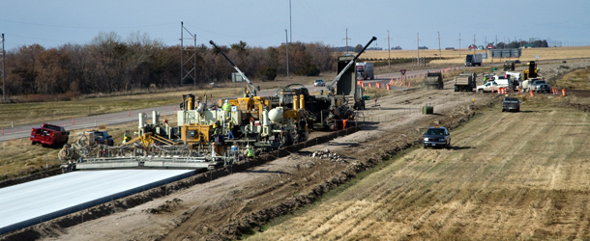
Do you have what it takes?
Generally, there are no specific educational requirements for an entry-level position in the highway construction industry.
You should be comfortable working with tools and be physically able to do the work; some heavy lifting may be required.
Many opportunities are available from office support to pilot car drivers to hands on laborer. Become familiar with the type of work you are most interested in.
Notes:
Do you have what it takes?
Generally, there are no specific educational requirements for an entry-level position in the highway construction industry.
You should be comfortable working with tools and be physically able to do the work; some heavy lifting may be required.
Many opportunities are available from office support to pilot car drivers to hands on laborer. Become familiar with the type of work you are most interested in.

Slide 21
Module 3
Placement
Notes:
This section addresses placement, including, where to find jobs, applying, and interviews. It covers apprenticeships and education in greater detail. It also discusses employer expectations.
What to wear on the job, expectations for an employee.

Slide 22
Typical Job Requirements Include:
Good attitude
Willingness to work and show up on time
Access to reliable transportation and willingness to travel
Physical ability to do the work
Passing a drug test and/or background check
Soft Skills
Ability to communicate – cell phone, email, voicemail
Notes:
Education:
Entry-level highway construction jobs have minimal, if any, education requirements. Apprentice laborers, and especially those seeking formal education are expected to have a high school diploma or General Equivalency Diploma (G.E.D.). High school classes in English, math, shop, and welding, as examples, will prove valuable.
Advanced (construction trades) positions require additional training, experience, licensing, and certification. In addition, community or technical colleges offer such courses, and trade study programs.
Coordination:
Balance, depth-perception, and hand-eye coordination are critical to accident prevention.
Strength and Endurance:
Physical ability to do the work. To walk and carry items. Construction work often requires heavy lifting. Physical fitness may be essential to certain job tasks. Highway construction may require long hours on foot, often performing labor-intensive tasks.
Transportation:
Access to reliable transportation will be needed in order to get to job sites. Job sites change throughout the year. In addition, willingness to travel to other cities and states will afford additional opportunities. A driver’s license will prove useful.
Background Checks:
Employers will likely conduct a thorough background check. Results of the background check do not necessarily eliminate candidates. It may determine when and where you are eligible to work. Keep in mind that many employers require pre-employment drug screenings and random or occasional testing, once hired.
US citizenship or green cards are required for employment.
Soft Skills:
Entry-level and skilled labor jobs require “soft skills”
Soft skills are personal characteristics that enable workers to interact well, increase productivity, and ensure safety. The most important soft skills are:
Ability to communicate with co-workers.
Ability to work as a team.
Dependability.
Communication Skills:
Effective communication is vital to the successful completion of any construction project. You must have the ability to communicate with cell phone, email, voicemail. Identify the necessary points of contact and use them appropriately.
Communication is key to safety. It is a team effort. The construction industry is focused on safety.

Slide 23

SAFETY EXPECTATIONS
The construction industry is focused on safety. Most companies provide OSHA and other safety training. In addition, they can provide:
  Clothing/Safety Vests
  Hard Hats
  Foot Protection
  Hand Protection
  Eye/Face Protection
  Hearing Protection

Slide 24
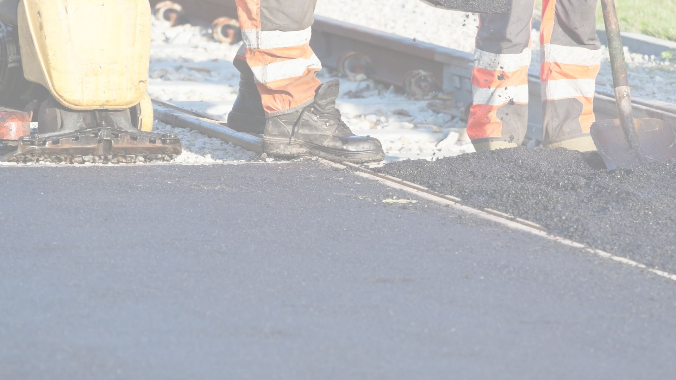
Typical Job Expectations
8 to 12 hour days
Overtime Opportunities
Work outdoors
Travel
Work independently and as part of a team
Be on time and dependable
Flexible job locations
Get a workout and while you work!
Notes:
The importance of communication in construction cannot be overstated. It is important to determine a chain of command for communication on a construction site. A construction project requires many different people with different skills to execute the project.
The project owner is the person in charge of the construction project. The general contractor is the project owner’s “right hand man” (or woman). Architects or engineers are involved in design, safety management, communication. Subcontractors perform specific roles on projects. Suppliers provide a variety of materials used on a project. Inspectors monitor construction sites throughout all phases of the project. The superintendent oversees the operations of a construction site. It is important to know who you report to and what is expected on the job.
Show video on the next screen

Slide 25

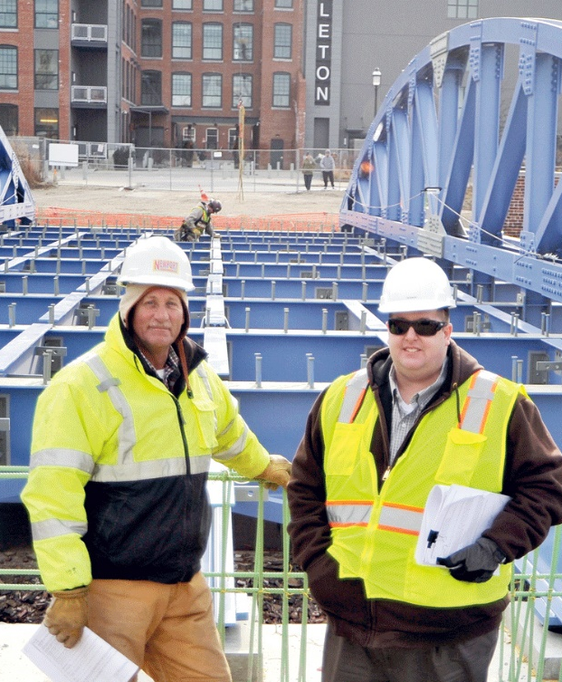

Video
http://www.buildsouthdakota.com/real_story/framing-apprentice/
Notes:
https://www.youtube.com/watch?v=TQkB7rABOZU&feature=emb_logo

Slide 26
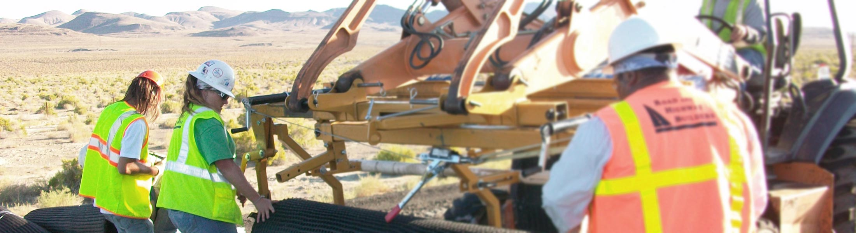
Where to find a job in construction?
Referrals/Word of Mouth
Networking
Department of Labor
Employment Agencies
Contractor Website
Career Resource Centers
High Schools and Colleges
Social Media
Newspapers
Radio
Notes:
Locating Career Opportunities
With a shortage of skilled workers in South Dakota, highway construction jobs are plentiful. There are many resources available to help locate these types of opportunities. Some of the best resources include:
South Dakota Department of Labor & Regulation (DLR). The DLR provides training and education for people seeking employment in South Dakota. Links to jobs and training opportunities, programs, forms, and more on the DLR’s website. Additionally, there are 16 local job service offices throughout the state. Staff are happy to help people find jobs.
Local contractors. Contact local companies about opportunities
AGC of South Dakota Jobs Bank: http://agc-sd.ourcareerpages.com/
Networking. Develop contacts in the industry and be on the lookout for networking events; these are often listed on the DLR or networking sites such as meetup.com and Eventbrite. Social media can be a good source, as well.
- Referrals/Word of Mouth
Employment agencies. Staffing agencies are a great resource for workers. They focus on matching worker skills with suitable jobs and, there is generally no charge to you for using their services. The DLR is one example; other agencies in South Dakota include Kelly Services and Adecco Staffing.
Attending job fairs. Job seekers attend career fairs to ask questions about interests and opportunities. Job fairs broaden knowledge and help land positions. There are many sources to find job fairs including:
- Contractor Websites
- Newspapers
- Radio
- Flyers
Training and Apprenticeship Opportunities
The following are many opportunities for participants to gain further experience and training in the construction industry:
- Youth apprenticeship programs
- Adult apprenticeship programs
- On-the-job training programs
- Commercial Driver License (CDL) training
- Certificate programs
- Technical and College degree programs

Slide 27

How to Apply
Applications
Create a resume that includes:
  Employment information and past experience
    Can be paid or volunteer
  Education experiences
  Skills or Certifications
  Contact information
  References
Interviewing
Post-Interview Follow-up
Notes:
Applications:
Employers typically require a completed job application. Furthermore, employers may require a resume for skilled laborers and diploma holders. Include employment dates and responsibilities on applications and resumes.
Contact information is a key part of a resume. It is recommended that you create a list of references to provide at time of application and/or interview.
Interviewing:
Arriving 15 minutes prior to scheduled appointment times makes an impression on employers. Come prepared. Bring a completed application and/or a resume.
Before the interview, research the company’s services, projects, and clients. This shows interest in working for the company. It also helps prepare interviewees to ask questions. Prepare a list of questions; Employers expect interviewees to ask questions.
At the interview, dress well. Wear clean clothing without holes. State interest in the job and project confident body language. Sit up straight, look interviewer in the eye, smile.
Be poised and calm. Take your time and be specific. Ask questions and ask about next steps in the hiring process. Be honest. Be polite and friendly to everybody. Avoid slouching, crossing arms, or fidgeting. Avoid telling jokes and controversial topics. Avoid speaking negatively about current or past job or boss.
Post-Interview Follow-up
Send a thank you note to interviewer. Think of it as a follow-up “sales” pitch; reiterate interest in the job, highlight qualifications, and mention significant contributions to this position This is also the perfect opportunity to ask questions and to discuss anything of importance the interviewer failed to mention.

Slide 28




The construction industry is looking for you to
fill in-demand positions.
Are you willing to work hard?
Are you looking to build a career?
Are you willing to show up on time and be dependable?
Are you ready to earn a good income?
Opportunities are available for you!

Slide 29

We need you to fill jobs in South Dakota!
Next Steps:
1. Have your updated resume ready.
If you don’t have one, we can help you prepare one.
2. Meet with contractors.
Notes:
Use this slide for job fair option.

Slide 30

Thank You and Good Luck!

