Slide 1
Buy America/BABA Updates

Slide 2
Final Rule on Manufactured Products
Modifies 23 CFR 635.410:
  With two express exceptions, requires classification of an article, material, or supply only as an iron or steel product, a manufactured product, or other products as specified by law or in 2 CFR Part 184 for projects
  Essentially, all materials on a project are classified into only one category, or bucket
    Based on their status at the time they are brought to the work site for incorporation into the infrastructure project
Notes:
An article, material, or supply shall only be classified into one category based on its status at the time it is brought to the worksite for incorporation into an infrastructure project, with just two exceptions, discussed later.
23 CFR 635.410 = Buy America
2 CFR Part 184 = Build America, Buy America (BABA)

Slide 3
Bucket 1 – Iron or Steel Products
“Iron or steel products” are defined as articles, materials, or supplies that consist wholly or predominantly of iron or steel or a combination of both
FHWA further defined “predominantly of iron or steel or a combination of both” as a material where the cost of the iron and steel content exceeds 50 percent of the total cost of all its components
Notes:
If something is wholly or predominantly iron and/or steel, it is classified as an “iron or steel product”

Slide 4
Bucket 2 – Manufactured Products
“Manufactured products” defined as articles, materials, or supplies that have been processed into a specific form and shape or combined with other articles, materials, or supplies to create a product with different properties than the individual articles, materials, or supplies
Notes:
Little easier to define after going through construction materials and excluded materials (the next two buckets). Combinations of these = manufactured products.

Slide 5
Bucket 3 – Construction Materials
Non-Ferrous metals
Plastic & polymer-based products
Glass, including optical glass
Fiber optic cable, including drop cable
Optical fiber
Lumber
Engineered wood
Drywall
Notes:
List has not changed.
Requirements for these to be considered “produced in the United States” are in the SDDOT specifications (and 2 CFR Part 184)
Classification, again, is based on the status at the time the material or product is brought to the work site.

Slide 6
Bucket 4 – Section 70917(c) / Excluded Materials
Excluded materials are the same as BABA section 70917(c) materials as defined in 2 CFR 184.3:
Cement and cementitious materials;
Aggregates such as stone, sand, or gravel; or
Aggregate binding agents or additives
Notes:
Excluded materials are not subject to any applicable Buy America standard (steel or iron product, manufactured product, or construction material) if delivered to the project site on their own or in combination with other excluded materials.
Mixtures of excluded materials delivered to a work site without final form for incorporation into a project must not be classified as manufactured products and are not subject to FHWA’s Buy America requirements for manufactured products. To fit this exception, a mixture of excluded materials must be delivered to the work site without final form, such as with wet concrete or hot mix asphalt that has not dried or set before reaching the work site. FHWA considers such mixtures to not be manufactured products, though it may also contain minor additions of other materials.
Once an excluded material has been combined with a non-excluded material and processed into a specific shape or form, the new product is to be classified the same as any other material, regardless of the fact that one of its components is an excluded material. For instance, precast concrete may comprise cement, water, aggregates, and steel. When delivered to the work site, the precast concrete would be considered a manufactured product, unless the cost of the steel content exceeds 50 percent of the total cost of the precast concrete’s components, in which case it would be classified as an iron or steel product. The fact that precast concrete may include cement and aggregates, two excluded materials, is not relevant to this classification because those excluded materials are combined with other non-excluded materials.

Slide 7
The Bucket 2 Exceptions – Additional Compliance Requirements
ITS / Electronic Hardware Systems
ITS and other electronic hardware systems installed in the highway ROW or other real property and classified as manufactured products:
Cabinets or other enclosures made of iron or steel must also meet Buy America requirements for iron and steel
Precast Concrete Products
For precast concrete products classified as manufactured products:
The iron and steel components must also meet Buy America requirements for iron and steel
Notes:
Precast concrete and ITS products that are classified as iron or steel products (so greater than 50% to cost of components are iron or steel) must be treated as iron or steel products and are only subject to FHWA’s Buy America requirements for steel and iron

Slide 8
55% Requirement
For projects obligated on or after October 1, 2026, the manufactured product must be manufactured in the United States and the cost of the components of the manufactured product that are mined, produced, or manufactured in the United States must be greater than 55 percent of the total cost of all components of the manufactured product.
Notes:
The 55% rule is part of the 2026 Specifications which take effect with projects in the October 7 Bid Letting. These projects are currently advertised for letting.

Slide 9
SD Approved Products List
All current Approved Products requested to submit certification of compliance
Any who couldn’t or were unresponsive were removed from the APL – many items were removed so be checking the updated list
If you have questions about current products for the Oct. 7 letting, contact your suppliers, manufacturers, or the SDDOT for more information

Slide 10
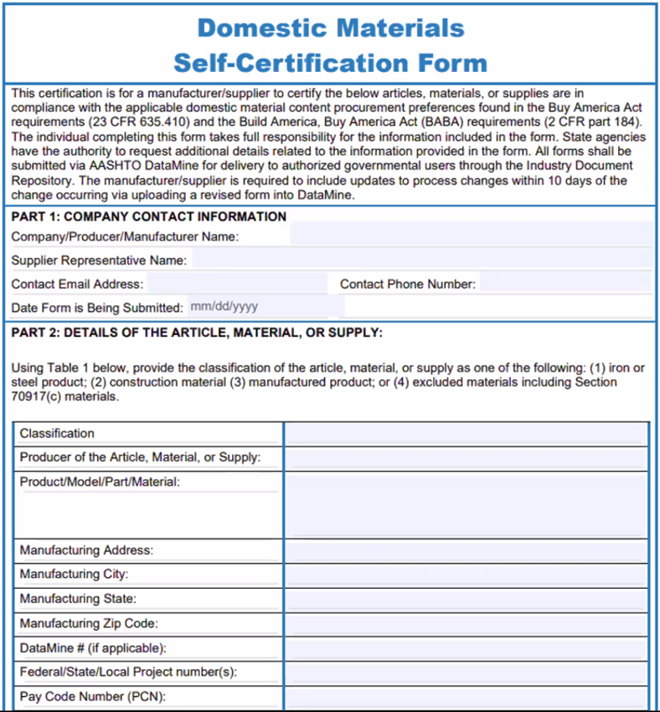
AASHTO Datamine Industry Document Repository (IDR) Form
For a manufacturer/supplier to certify materials or supplies are in compliance with the applicable domestic material content procurement preferences found in the Buy America Act requirements (23 CFR 635.410) and the Build America, Buy America Act (BABA) requirements (2 CFR part 184).
https://transportation.org/product-evaluation-and-audit-solutions/domestic-materials-self-certification-form/
Notes:
There is also a national repository for products that manufacturers or suppliers want to certify they meet Buy America.
Go to the web address here or search “AASHTO Datamine IDR form.” There are guides for industry and state agency users.
Encourage suppliers and manufacturers to do this, which would constitute documentation of the product’s compliance.

Slide 11
Applicability
Buy America requirements apply to all items on Federal-aid highway projects
  City projects let in conjunction
  Utility relocation agreements
  Non-participating items
  City or other agency furnished items

Slide 12
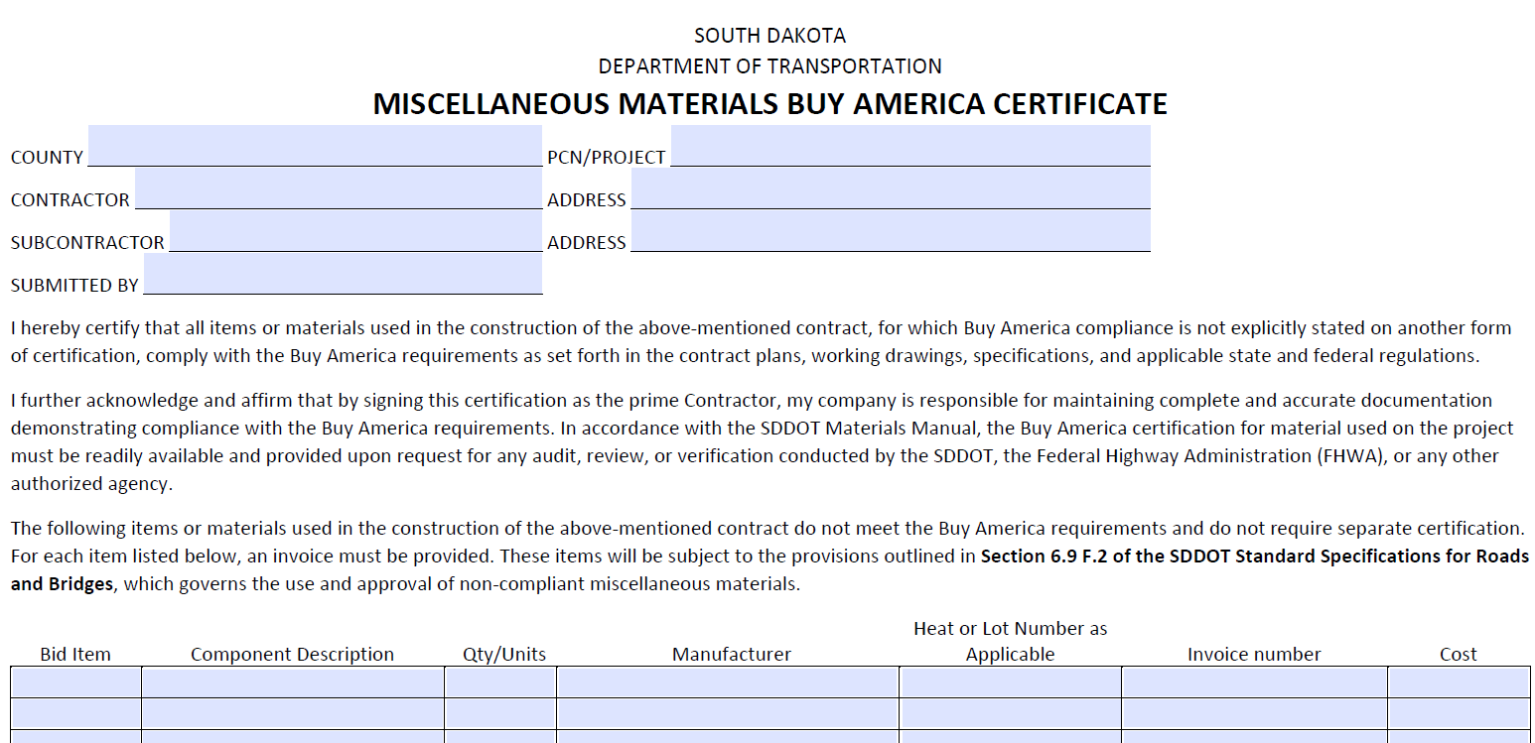
Certification
Certification is required prior to permanent incorporation into the project
Notes:
SDDOT has a form online (Inside SDDOT > Forms & Publications > Forms) called the Miscellaneous Materials Buy America Certificate. This form is to be used for all products requiring Buy America compliance that do not have another form of certification, such as a mill cert.
The form is certifying that all other products requiring compliance on the project meet the applicable standards.
The form is signed by the Prime Contractor and acknowledges responsibility to maintain documentation for compliance.
If there are materials that do not meet Buy America requirements, they must be listed on the form and an invoice provided. Reference is made to Section 6.9 F.2 of the specs which governs use and approval of non-compliant items.

Slide 13
Unavailability of Materials
If the Contractor discovers a Buy America compliant item does not exist or an item becomes unavailable, the Contractor will immediately notify the Department.
The Contractor will furnish written documentation of the Contractor’s complete efforts to obtain a compliant item.
  This documentation will include a complete contact log with dates and times of the Contractor’s efforts to obtain a compliant item, the responses received, and any correspondence between the Contractor and potential suppliers of the item which demonstrate efforts to obtain a compliant item.
Notes:
SDDOT specifications require proof of effort to obtain compliant materials and an actual lack of available compliant materials. Slightly higher cost, different supplier source, or a longer lead time does not grant an exception to the requirements.

Slide 14
10/7/2026 Electronic Spec Book Updates

Slide 15
General Information
All changes marked with line in right margin
Several special provision relocated to the spec book
Several plan notes relocated to the spec book
Not all changes will be shown here. Read the spec book for the most accurate information.

Slide 16
Division 1 Updates
Section 4.4 – Price Schedule for Miscellaneous Items were all updated.
Section 4.6 (old) – Final Cleaning Up moved to Section 5.16.
Section 5.2 – Plans and Working Drawings – Requirements for shop plans relocated from various sections to here.
Section 6.9 – Buy America updated for new requirements from CFR.
Section 7.14 – Rewritten to clarify insurance requirements.
Section 7.22 – American Security Drone Act special provision included.
Notes:
Price Schedule
Shop Plans
Insurance

Slide 17
Division 1 Updates (continued)
Section 8.4 – New requirement for notification of weekend work by Thursday prior.
Section 8.4 – Written narrative required with baseline schedule for Category II and III projects.
Section 8.7 – Revised Special Provision for Contract Time portion to include options for calendar day count basis in addition to working day count basis.
Section 8.9 – Schedule of Liquidated Damages new range for projects $50 million and over added.
Notes:
Schedule
LD’s

Slide 18
Division 1 Updates (continued again)
9.4 – Compensation for Contract Changes – Added clarification of markup, bond, insurance, tax, and profit for itemized breakdown of negotiated prices.
Section 9.7 – Updated interest rate due when payment is delayed.
Notes:
Price breakdown

Slide 19
Division 2 Updates
Section 110 – Added the note for paint may contain lead.
Section 120 – Title changed to “Excavation and Embankment Construction.”
Section 270 – Remove “Base” from granular base material items. Bid item file heading.
Section 320 – Flexible Pavement Smoothness special provision added. Plan notes will identify IRI smoothness projects and opportunity levels.
Section 322 – Table H - % passing 3/8” sieve increased from 85% to 87%.
Section 324 – Added MSCR binders. Updated tack rates from plan notes.

Slide 20
Division 2 Updates (continued)
Section 330 – Clarified prime language. Language added for dilution of emulsion for rates exceeding 0.07 gallons per square yard.
New Section 333 – Micro-Milling Asphalt Concrete special provision added.
New Section 340 – Polymer-Modified Micro Surfacing special provision added.
New Section 355 – Asphalt Concrete Crack Leveling special provision added.
Section 360 – Special provision for AST design added.
Section 380 – All PCCP smoothness special provisions added.

Slide 21
Division 2 Updates (continued again)
Section 380 – Dowel bar placement tolerances removed. Covered by Standard Plates.
Section 380 – Slump for formed and slip form concrete updated.
Section 380 – Added Engineer approved alternatives to printed tickets.
Section 390 – Updated opening to traffic strengths
New Section 395 – High Friction Surface Treatment special provision.
Section 410 – Bolting requirements include Contractor providing a Skidmore bolt tester. Updated bolting requirements for time requirement for final pre-tension to be completed after snug tight.

Slide 22
Division 2 Updates (continued again 2)
Section 410 – Both Special Provisions for stud shear connector added.
Section 411 – New Structural Steel Painting – Shop painting and field painting of new steel. Incidental to steel. The outside face of the facia girder will only receive primer in the shop, and a professional painter will be required for field paint including all touch up for new steel.
Section 412 – Bridge Field Spot Painting – Spot field repainting using hand and power tools including containment and disposal of residue by the Contractor. Contractor is responsible for testing and providing a daily log of weather and test results. Requirements for soluble salt testing if specified.

Slide 23
Division 2 Updates (continued again 3)
New Section 413 – Bridge Field Repainting – Entire structure repainting using abrasive blast cleaning with containment. Includes containment and disposal of residue by the Contractor. Contractor is responsible for testing and providing a daily log of weather and testing results. Requirements for soluble salt testing if specified.
Sections 430, 435, 680, 681, 990, & 991 – terminology change for drainage tubing, underdrain pipe, dual wall HDPE Pipe, PVC Outlet Pipe, etc.
New Section 455 – CIPP Liners special provision moved.
Section 460 – Concrete Penetrating Sealer special provision added.

Slide 24
Division 2 Updates (continued again 4)
Section 460 – Bridge Deck and Approach Smoothness special provision added.
Section 460 – Added Engineer approved alternatives to printed tickets.
New Section 463 – Cellular Grout plan note added.
Section 480 – Stainless Steel Reinforcement special provision added.
Section 491 – Added a 3 hour ASTM test for moisture to be ran before all first coat applications. Changed to a 7 shot blast profile from 5.
Notes:
Bridge deck polymer chip seal

Slide 25
Division 2 Updates (continued again 5)
Section 510 – Pile driving notes for required hammer and request for hammer not shown added. Test pile driven first and become part of pile group note added. Pre-bore notes added. Changed requirement for use of delayed bearing.
Section 550 – Title changed removed all latex modified notes.
Section 550 – Hydrodemolition notes added.
Section 560 – Self Consolidating Concrete special provision added.
Section 620 – Type 2A and Type 3A temporary fence added. Type 1, 2, 3 removed and property of Contractor. Type 1A, 2A, and 3A left and become property of Landowner.

Slide 26
Division 2 Updates (continued again 6)
Section 635 – Battery Backup System special provision added.
Section 635 – Emergency Vehicle Preemption systems (Optical and Siren) special provisions added.
Section 635 – Video Detection System special provision added.
New Section 681 – Special Provision for Edge Drains added.
Section 700 – Overburden Excavation for Riprap plan notes added.
Section 734 – Bridge Berm Slope Protection, Perforated Geocell, Coated Crushed Aggregate Slope Protection, and Quarried Aggregate Slope Protection added from plan notes.

Slide 27
Division 3 Updates
Section 750 – Cement spec updated related to changes to sulfate testing (affects cement suppliers).
Section 753 – Total rewrite of the fly ash spec to closely match current AASHTO spec for coal ash.
Section 820 – Added additional gradation sizes (needed for SCC concrete & spall repair).
Section 821 – Added PAMS cure to specs and moved all application rates to this section.
New Section 875 – Asphalt Repair Mastic.

Slide 28
Division 3 Updates (continued)
Section 880 – Added Modified Class S gradation from plan notes, removed Class S (Type 2). Added Class G (Alternate B) specification for Fine Aggregate Angularity from plan notes.
Section 881 – Removed Type 2C.
Section 884 – Consolidated tables in 884.2.D.
New Section 885 – Materials for Polymer-Modified Micro Surfacing.
Section 890 – Added MSCR binders. Removed RC and SC cutbacks. Updated tables.
New Section 991 – Drainage Pipe and Drainage Tubing requirements added.

Slide 29
Division 3 Updates (continued again)
Section 982 – Changed design requirements to AASHTO LRFD Standard Specifications for Structural Supports for Highway-signs, Luminaires, and Traffic-Signals.
Section 985 – Changed design requirements to AASHTO LRFD Standard Specifications for Structural Supports for Highway-signs, Luminaires, and Traffic-Signals.
Section 1010 – Added requirement that steel bar epoxy coating done by a CRSI certified epoxy bar fabricator.
Section 1010 – Stainless Steel Reinforcement special provision added.

Slide 30
Preparation for the Oct. 7 Letting

Slide 31
Preparation for the Oct. 7 Letting
Ensure products you’re bidding are compliant – be checking the updated Approved Products List
If you are aware of a product or material where a compliant version is unavailable, let us know right away → Q&A Forum
Obtaining a waiver for unavailability of a material is unlikely and would not be granted in the time between bidding and the end of the project
Familiarize yourself with the 2026 Specifications

Slide 32
Contact
Christina Bennett
Construction & Maintenance Engineer
South Dakota DOT
Christina.Bennett@state.sd.us
(605) 773-4391
Ryan Johnson
Senior Specification Engineer
South Dakota DOT
Ryan.Johnson@state.sd.us
(605) 773-8451

