Slide 1
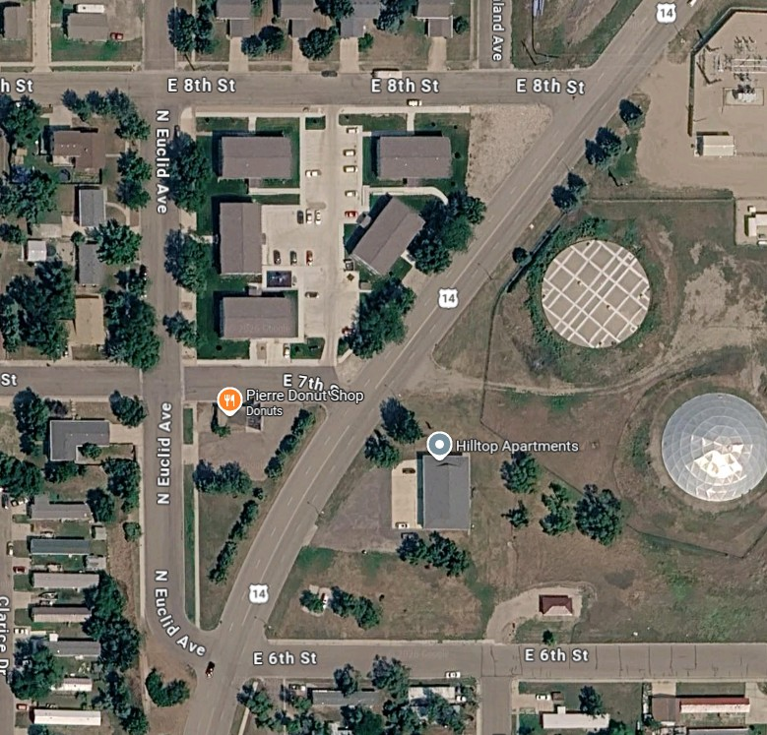
Traffic shift on north Euclid Avenue will be two-way thru the north end of the project.

Slide 2
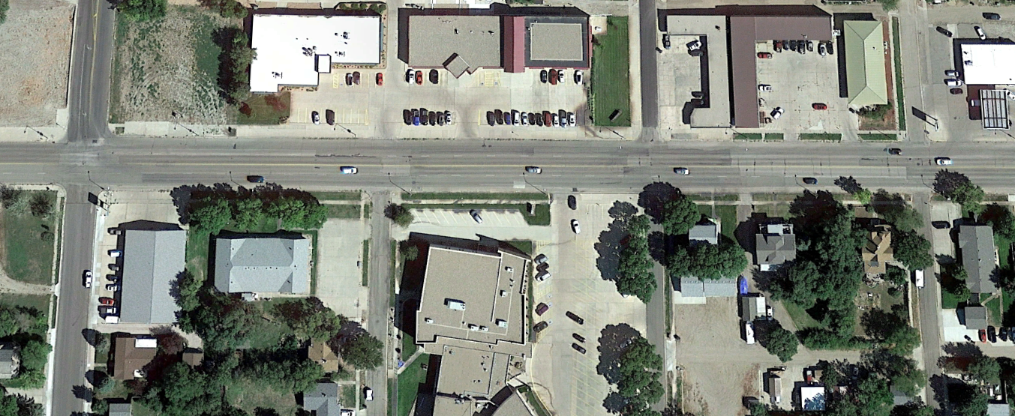
Traffic shift Wednesday, Oct. 14, 2026
from First Street to Fourth Street. Fourth
Street will be a four-way stopped condition.
Fourth Street
Third Street
Second Street
First Street

Slide 3


Text Notifications:
For updates on major traffic changes during the project, subscribe to a free text-in service. To subscribe, text “EUCLID" to 605-566-4041. Subscribers can unsubscribe at any time.

