Slide 1

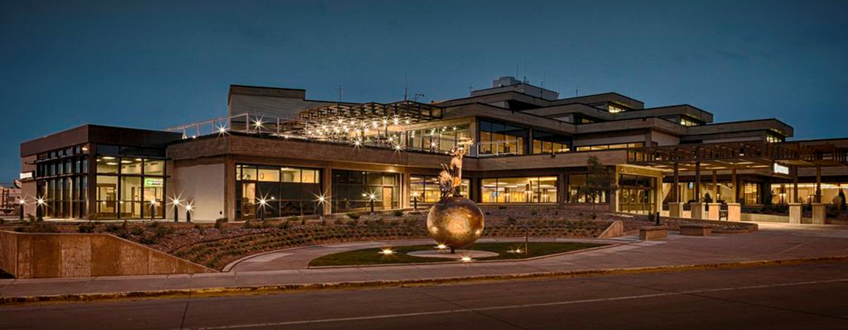
Welcome!
Rapid City Regional Airport
Airport Terminal
March 29, 2023

Slide 2

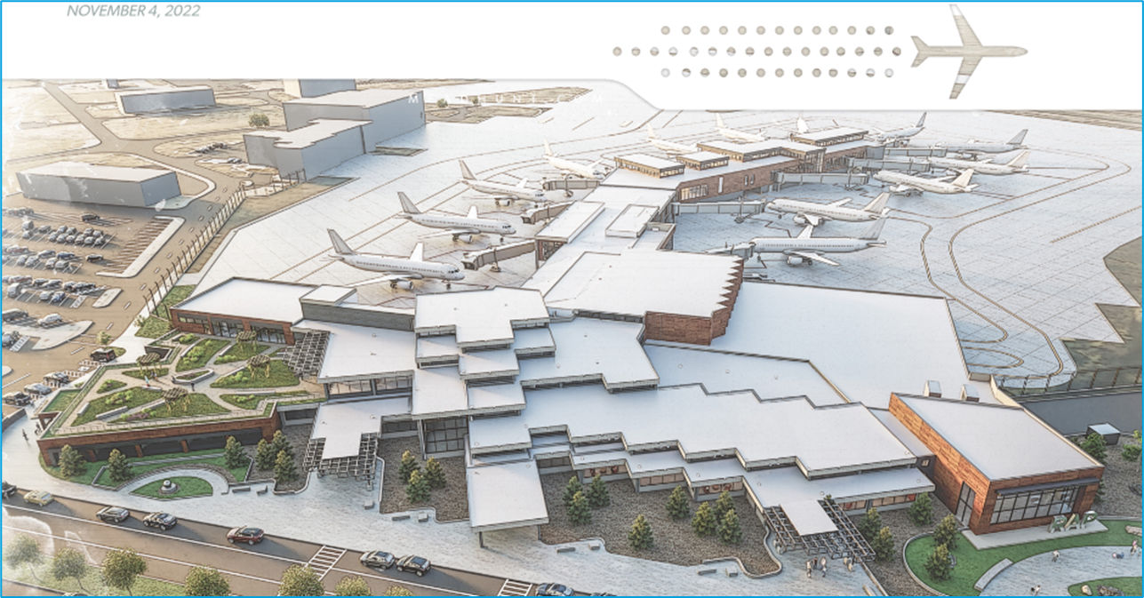
Today’s Agenda
Background
Issues/Solutions
Status
Questions

Slide 3
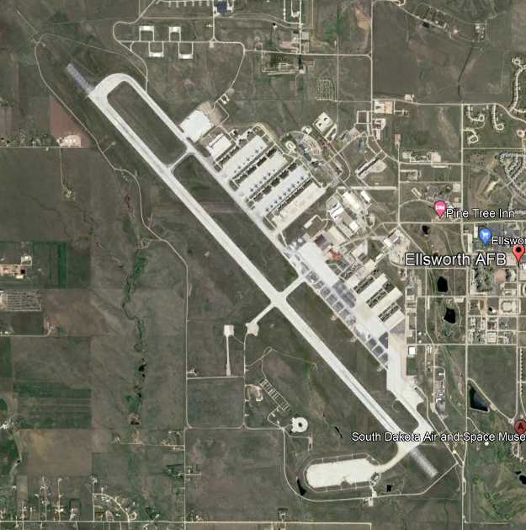
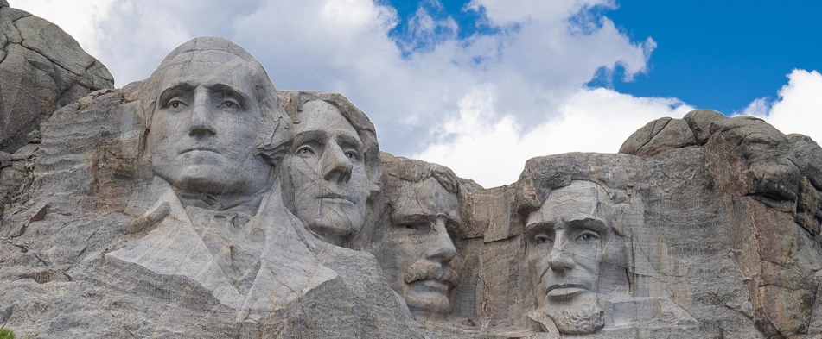

Rapid City – Black Hills
Economic Growth of Rapid City
  Expanded Ellsworth Airforce Base
  Increases Area Entertainment Venues
  Populations Growth Projects – “Fastest-growing Metro Area in the Midwest”
Notes:
Board presents – Adjust as needed/desired. 2-3 Minutes

Slide 4

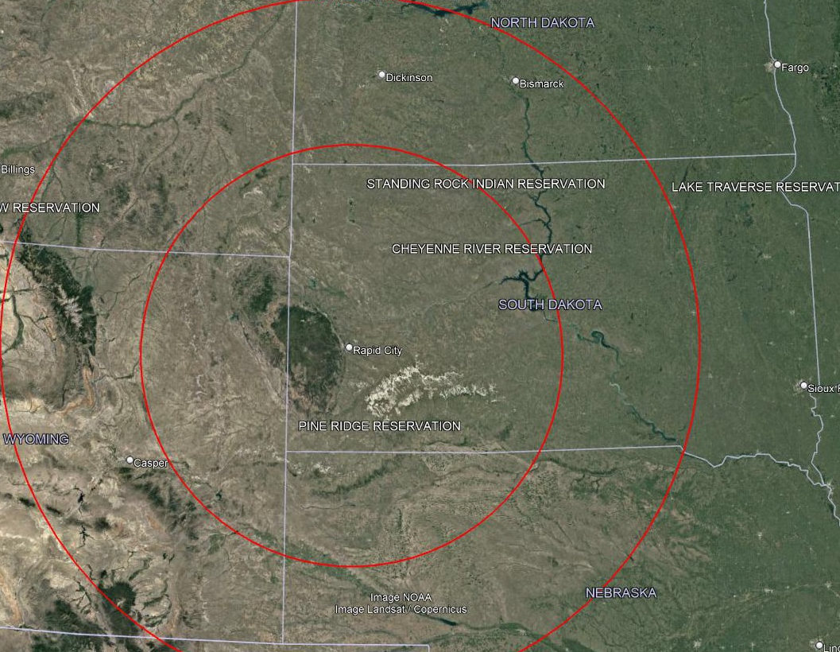
Rapid City Region
Geographically isolated
  ~300 miles to the next airport larger than RAP
  RAP would be closest WN service for a 5-state region
    Dickinson -> RAP = 3 hours
    Sioux Falls -> RAP = 4 ¼ hours
    Bismarck -> RAP = 4 ½ hours
Denver is a 412-mile, 6+ hour drive from Rapid City
  Far enough to create a strong local demand; however, a significant number of visitors today use Denver and drive up to the Black Hills.
South Dakota’s two major Airports (RAP & FSD) serve 94% of total SD traffic
Serves 2 historically disadvantaged areas; Black Hills and Pine Ridge (Oglala Sioux Tribe) Reservation
Notes:
Board presents – Adjust as needed/desired. 2-3 Minutes

Slide 5
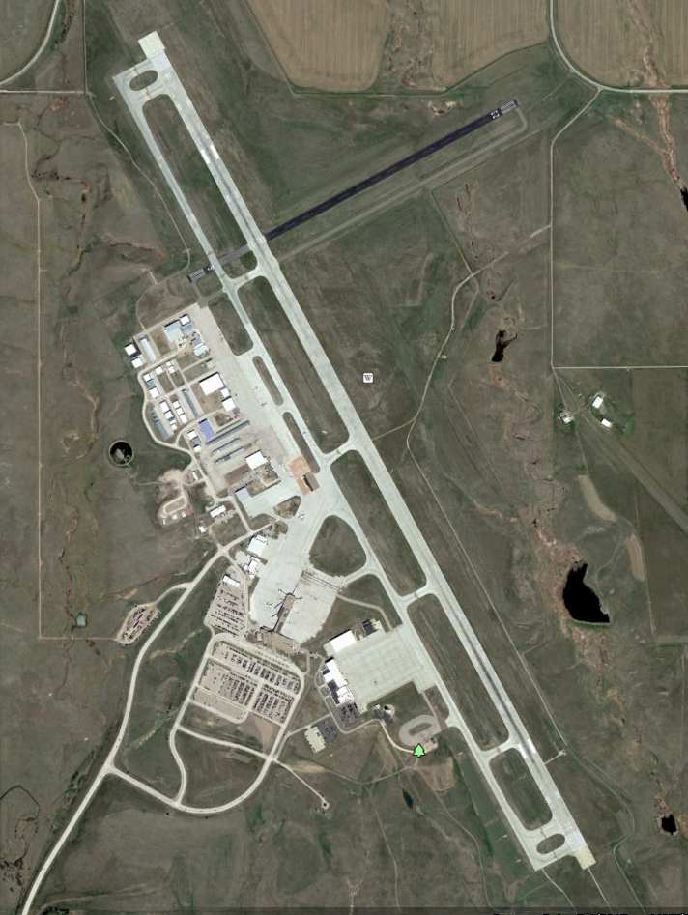
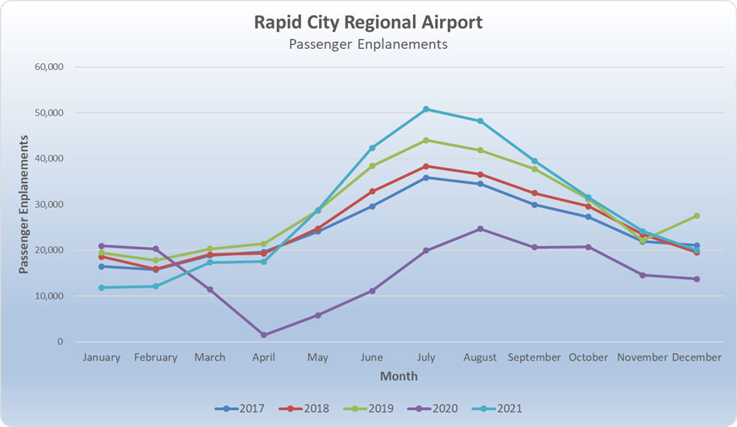
Our Airport
Passenger Enplanement = 350K (2019), 348K (2021)
Airlines – Allegiant, American, Delta, United, Sun Country
Non-Stop Destinations – 15 (9 seasonal)
Notes:
Patrick - Gate demand is driven by the number of summer non-stop hub connections.

Slide 6
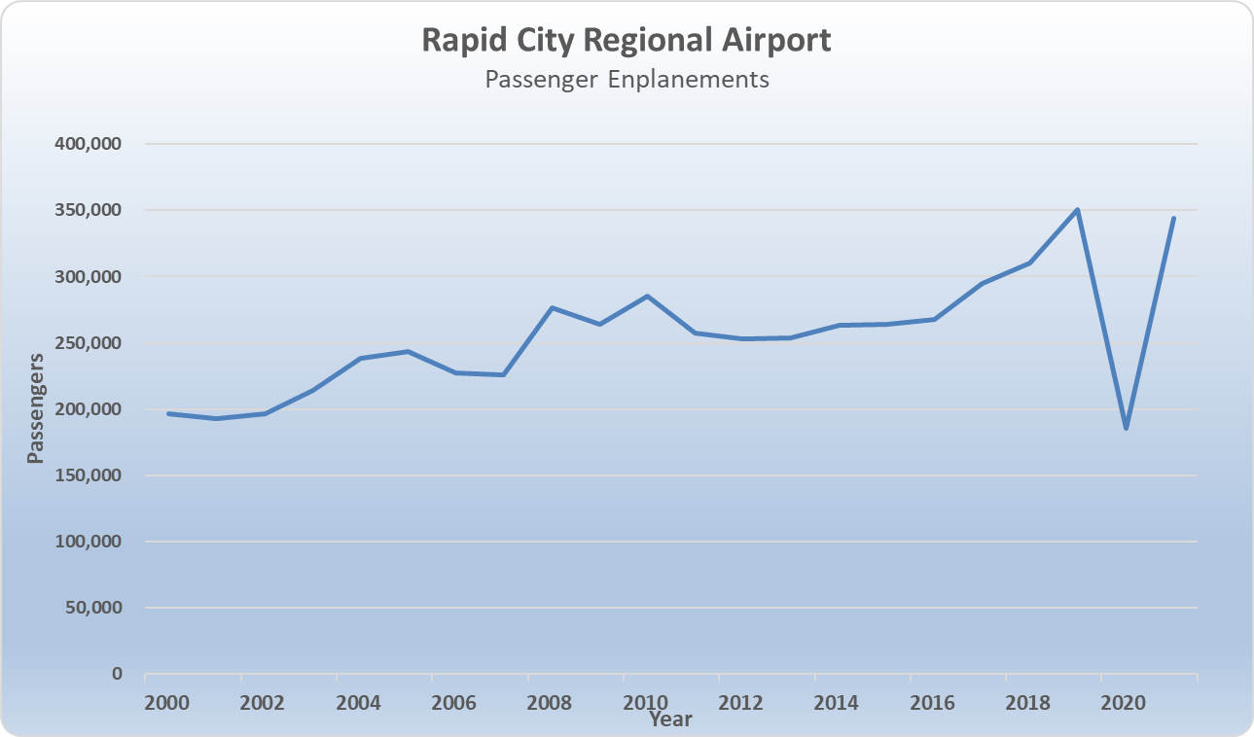

RAP Passenger Enplanements
30% Passenger growth from 2014-2019
2021 Return to normal from pandemic
70% of Enplanements occur from May-October

Slide 7
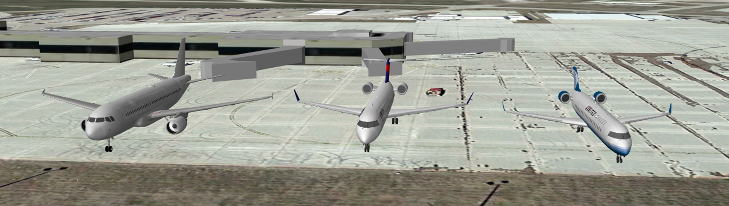
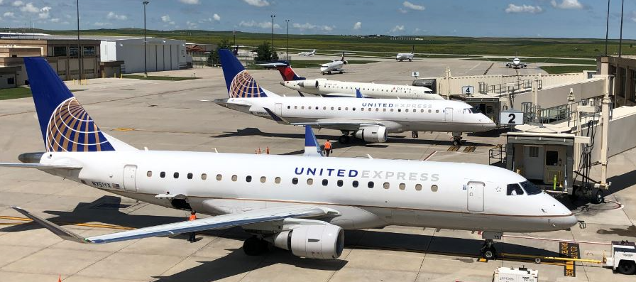
Key Factors
Airline Trends
  Air Service Conference attend by Patrick Dame/Jeff Hartz
    Airlines Key Pursuits – (Alaska, Breeze, Frontier, Jetblue, Southwest)
  Up gauging in Aircraft
    Regional Jets (50/76 passengers) vs Mainline Jets (128+ passengers)

Slide 8
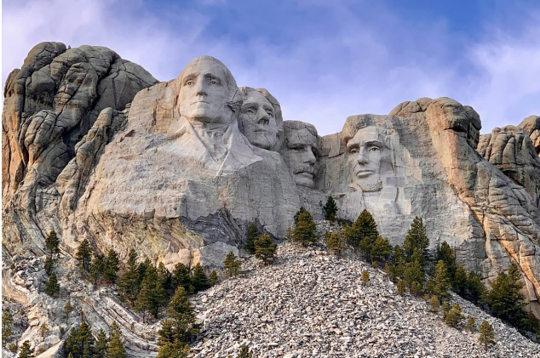
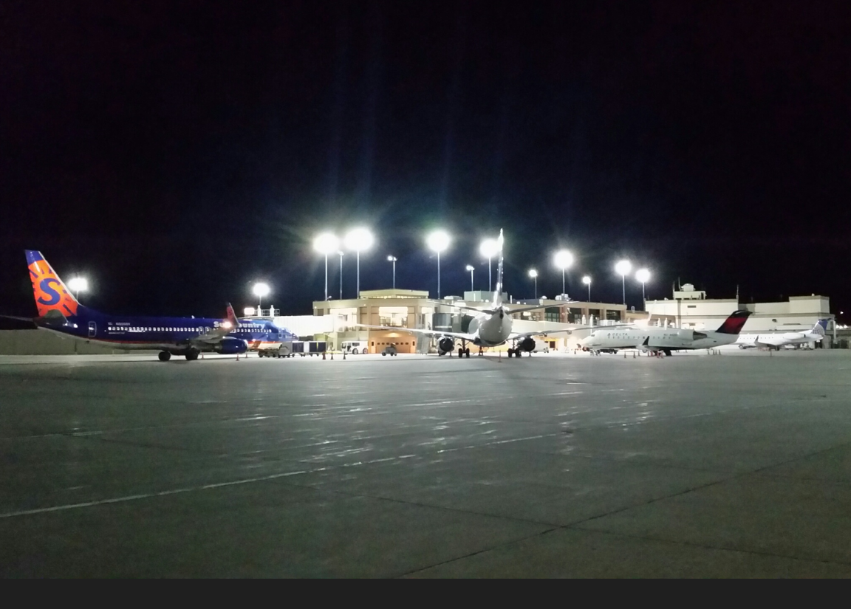
Scheduling Scenarios - NOW
Peaking characteristics were evaluated from the following schedules:
  Summer Weekend (07/24/2021)
  Summer Weekday (07/21/2021)
  Winter Average (02/06/2019)
394
282
Gateway to the Black Hills
146

Slide 9
Scheduling Scenarios - FUTURE
Peaking characteristics forecasted for the same periods but with the following air service growth for each period:
 | Summer Wknd. 2021 | Summer Wknd. 2030 | Summer Wkd. 2021 | Summer Wkd. 2030 | Winter 2019 Avg. | Winter 2030 Avg.
Departures | 31 | 40 | 26 | 31 | 11 | 14
Seats | 2,482 | 4,515 | 2,183 | 3,503 | 755 | 1,406
Seats/Day | 80 | 113 | 84 | 113 | 84 | 100
728
752
262

Slide 10
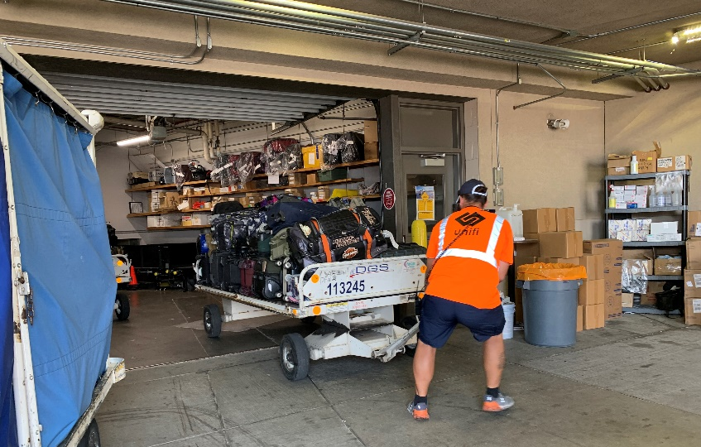
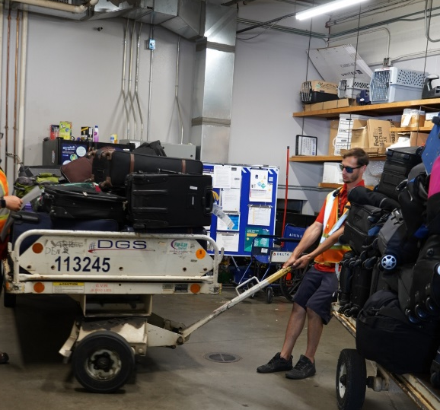
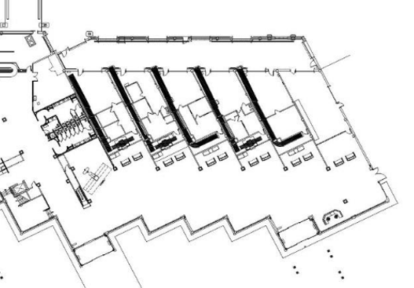
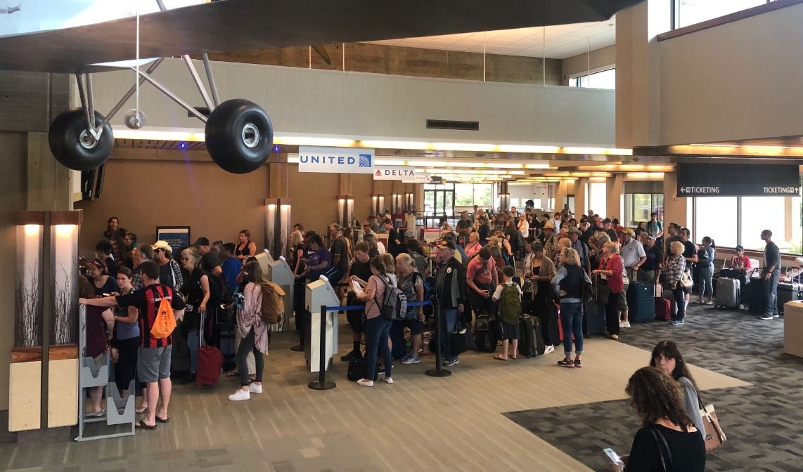
Issue – Ticketing and Baggage Makeup
Existing
Exhibit developed by Alliiance for Rapid City Regional Airport

Slide 11
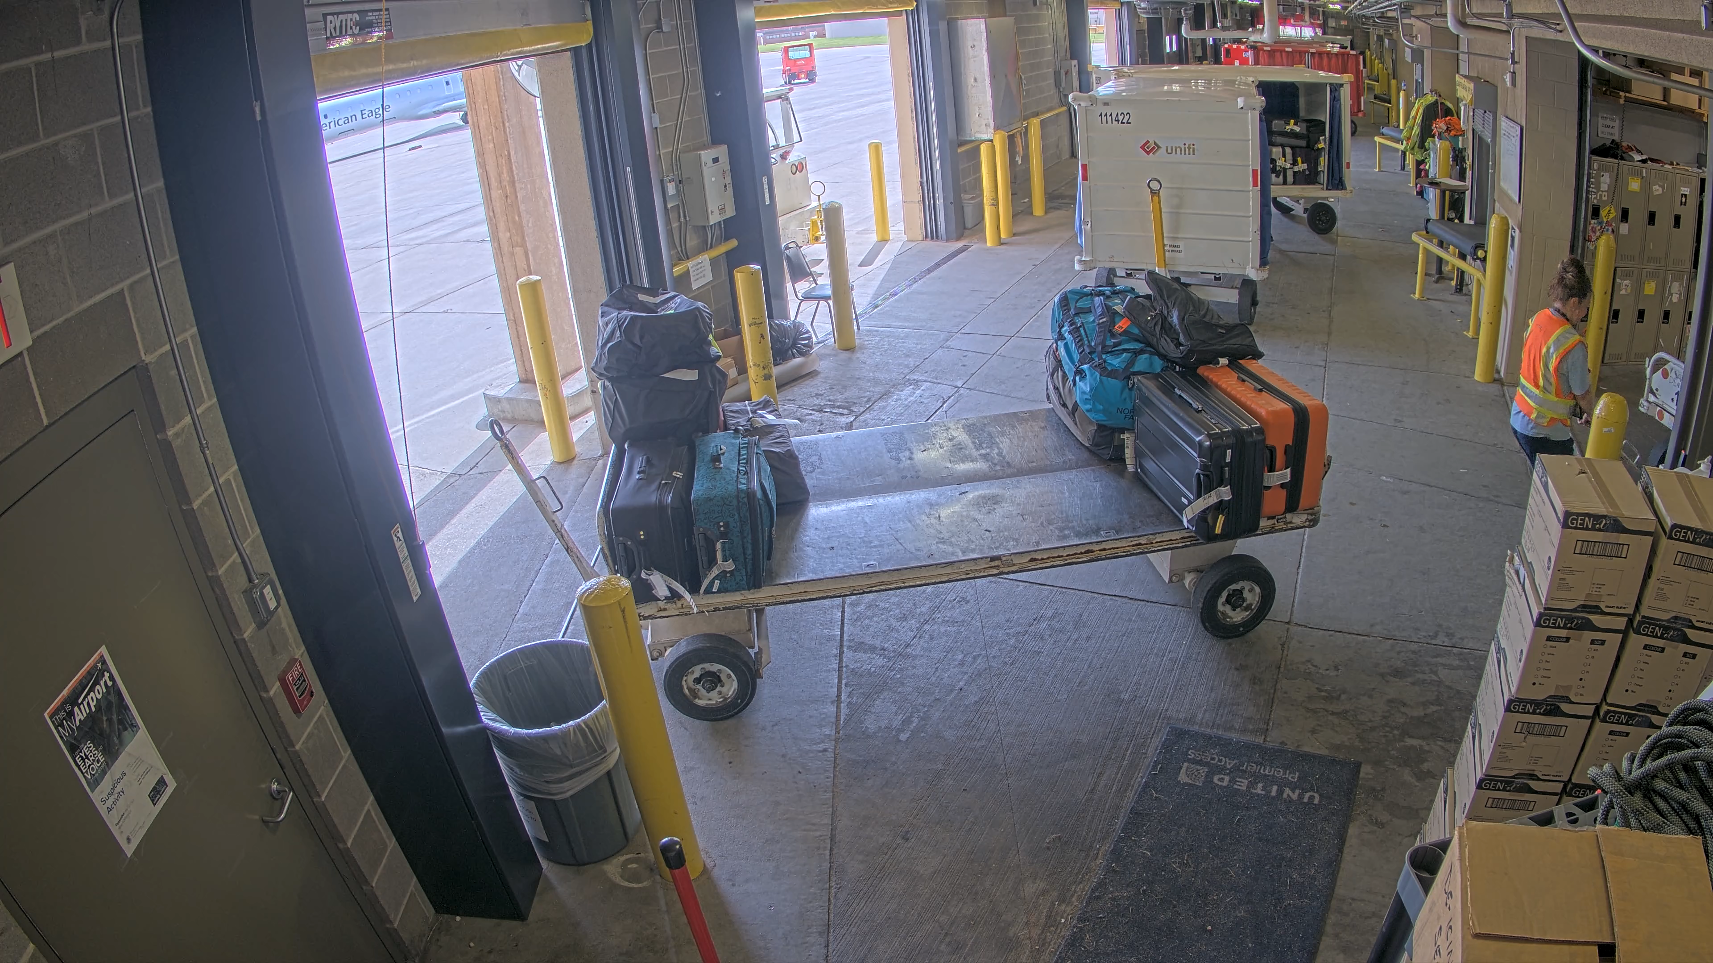
Issue – Ticketing and Baggage Makeup
Existing

Slide 12
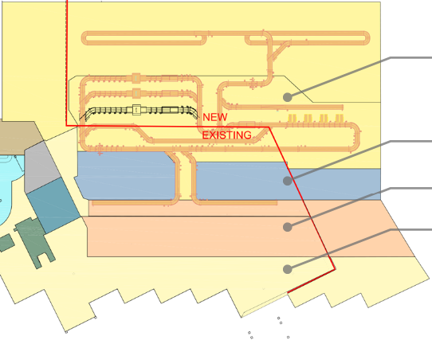
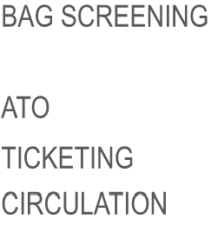
Solution – Ticketing and Baggage Makeup
Existing
Initial Proposed (TSA)

Slide 13
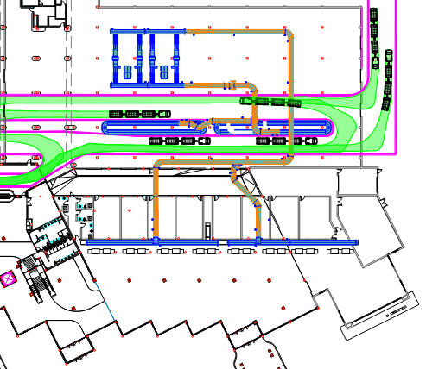
Solution – Ticketing and Baggage Makeup
Existing
Proposed

Slide 14
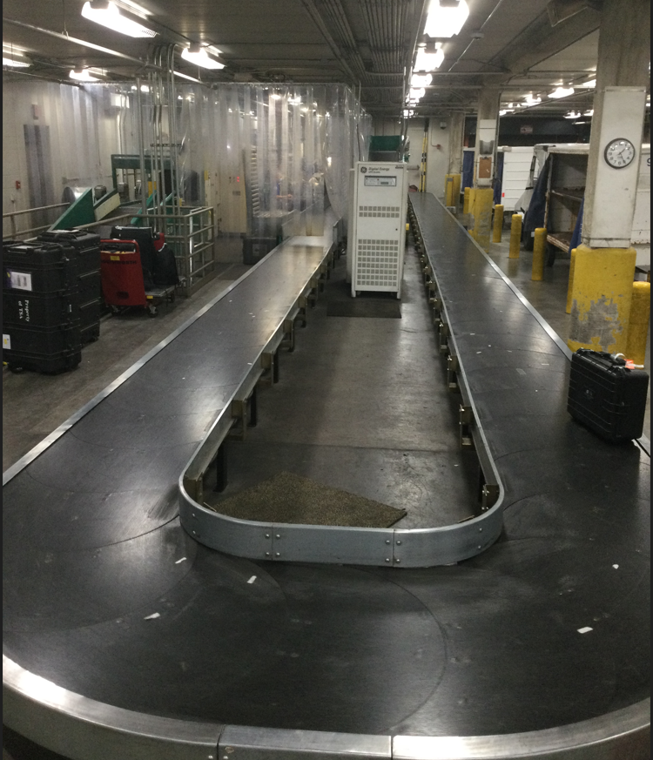
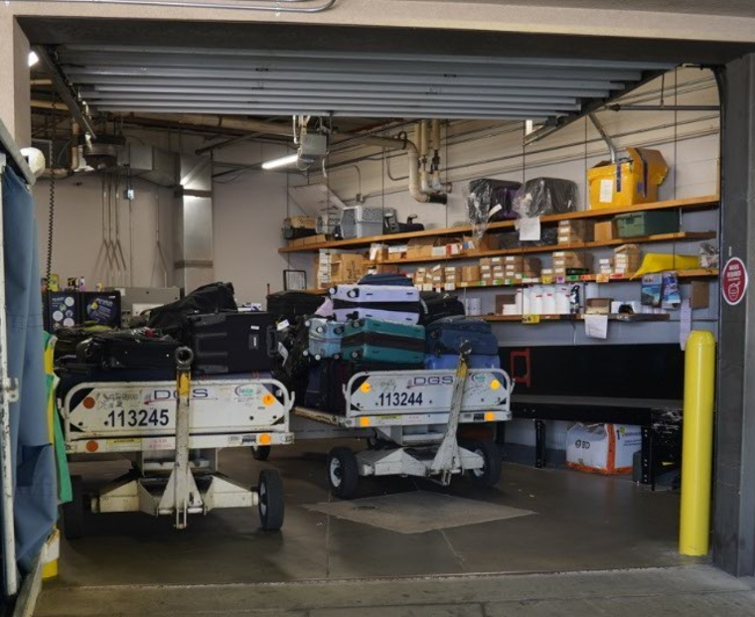
Comparison of Baggage Makeup
Bismarck - 214,637 enplanements
Rapid City - 348,269 enplanements
Baggage Carousel
Note: Drive Lane Next to Carousel

Slide 15
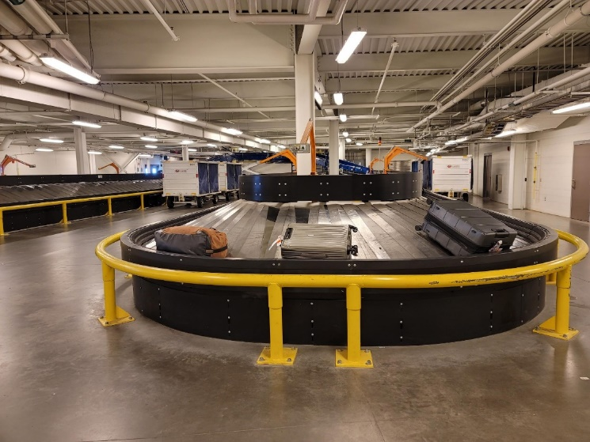
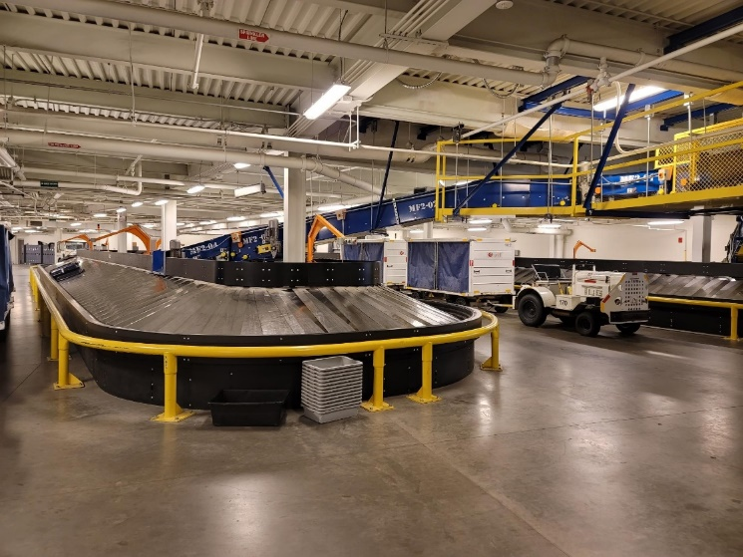
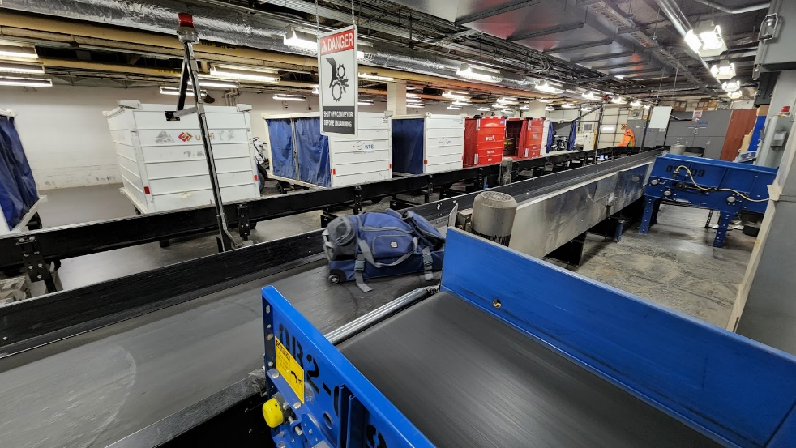
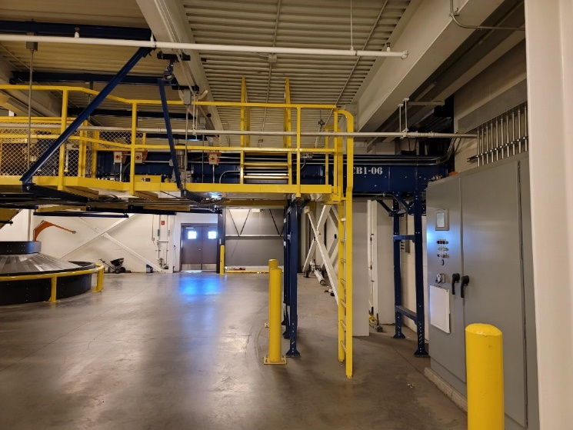
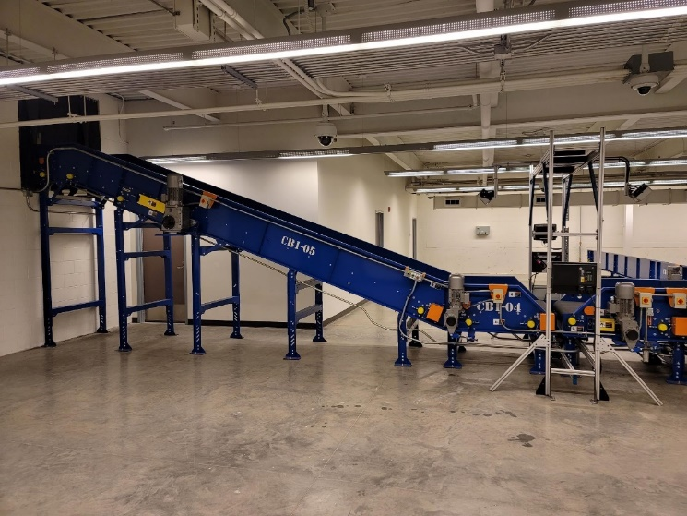
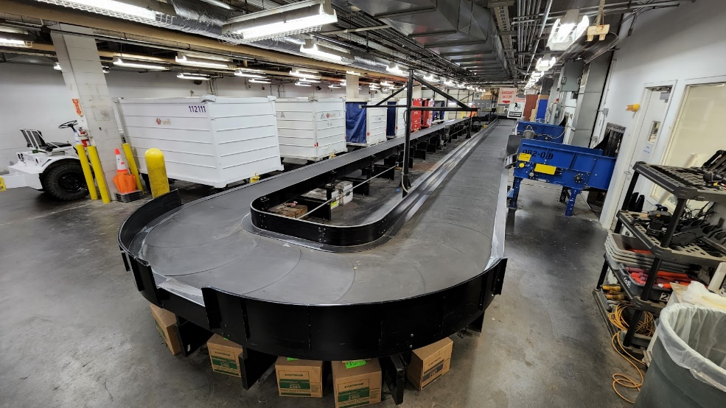
Minot, ND Baggage Makeup – 164,000 Enplanements - 63% smaller than RAP
Fargo, ND Baggage Makeup 480,000 Enplanements – 38% bigger than RAP

Slide 16
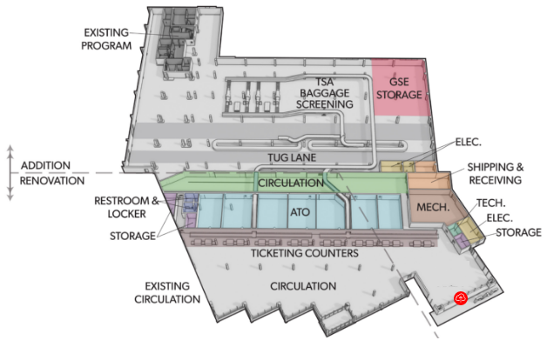
Solution – Ticketing and Baggage Makeup
Existing
Proposed

Slide 17
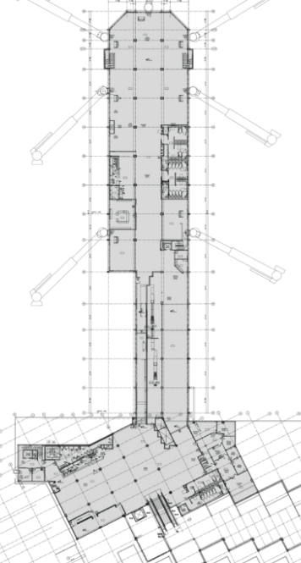
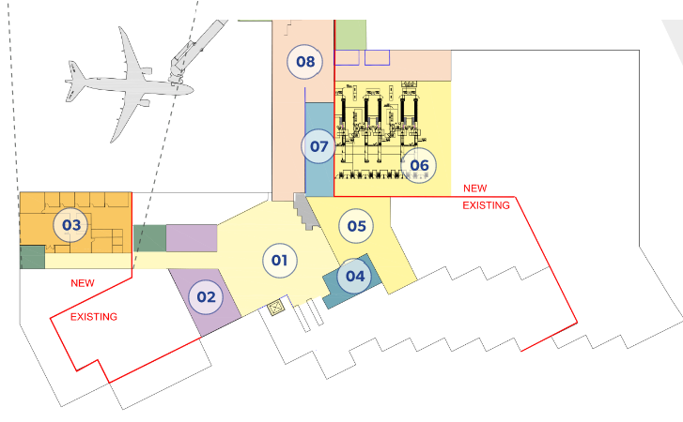
Issue – TSA Checkpoint
Proposed
Existing
Proposed TSA Checkpoint
Existing TSA Checkpoint
Exhibit developed by Alliiance for Rapid City Regional Airport

Slide 18
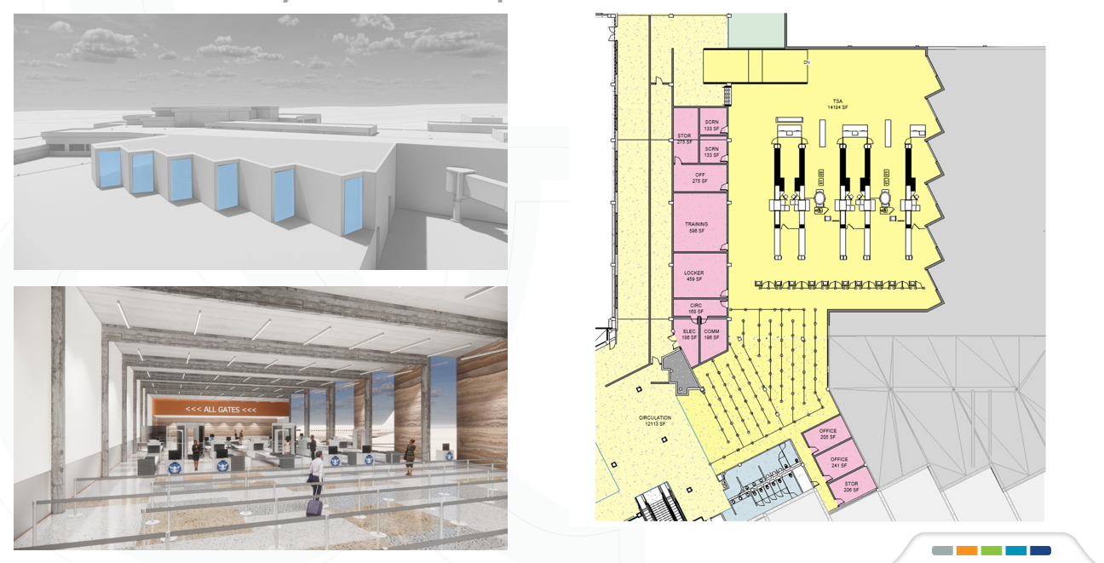
Solution – Ticketing and Baggage Makeup
Proposed

Slide 19
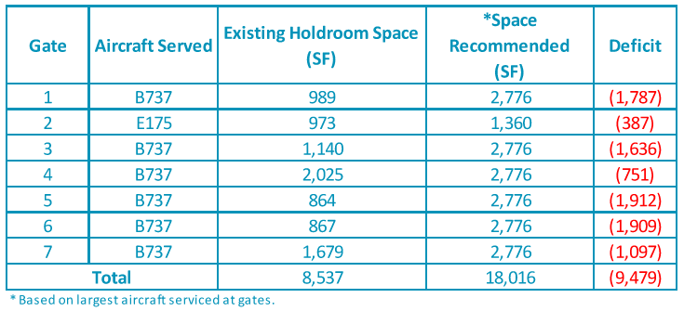
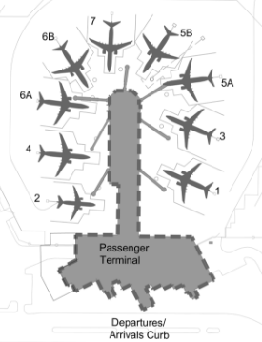
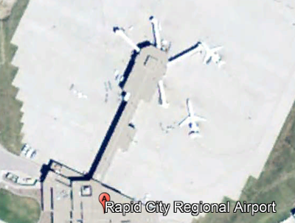
Issue – Concourse (Holdrooms/Gates)
Existing Layout – Holdroom Analysis
Existing
2010

Slide 20
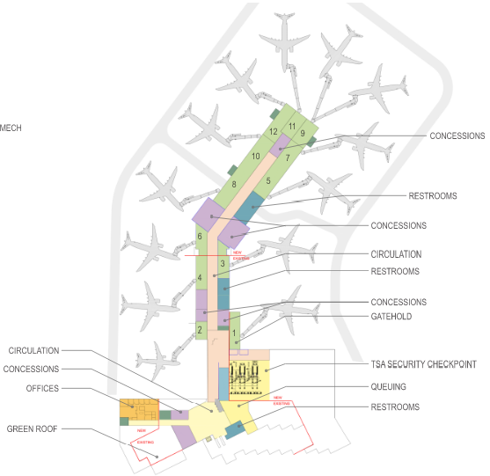
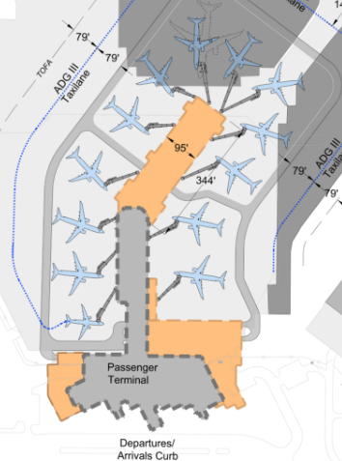
Solution – Concourse (Holdrooms/Gates)
Flexibility: All gates can accommodate a main line aircraft such as B737 except Gate 2 providing a feasible common-use layout.
Revenue Generating: Some holdrooms remain undersized to allow passengers to leak into concessions space.

Slide 21
Solution – Concourse (Holdrooms/Gates)
Proposed Layout – Holdroom Analysis
Proposed
Existing
Increase # of Gates
Increase Holdroom Size

Slide 22
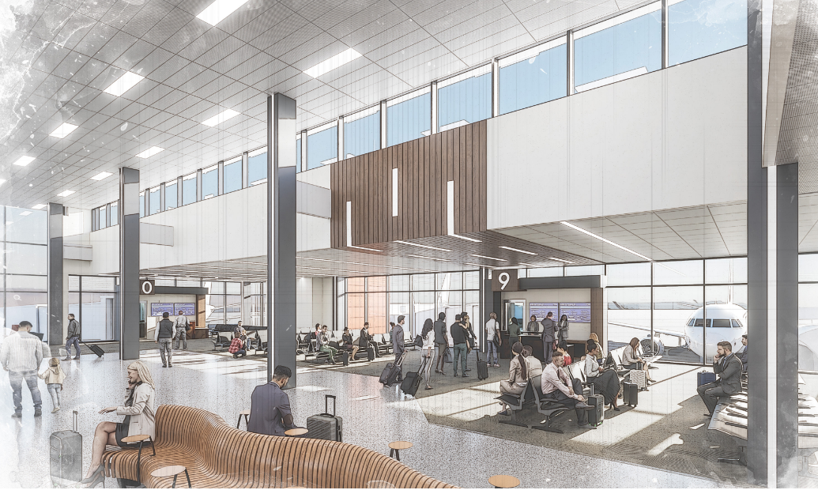
Solutions – Concourse (Holdroom/Gates)

Slide 23
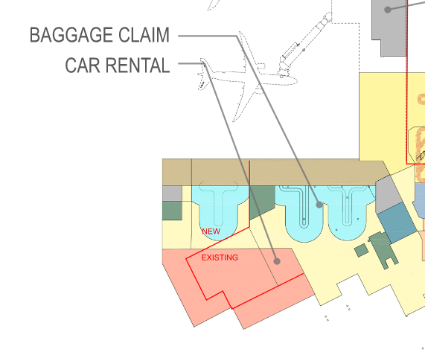
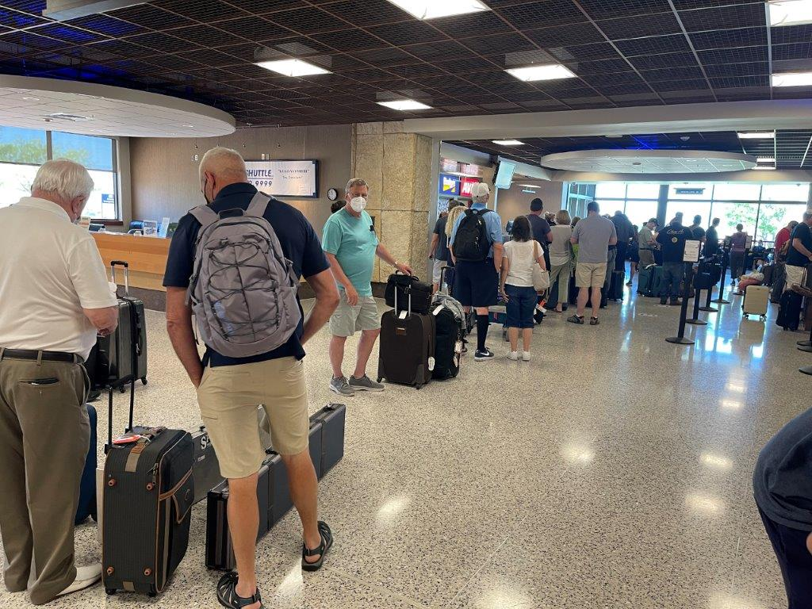
Issue - Rental Car Area and Baggage Return

Slide 24
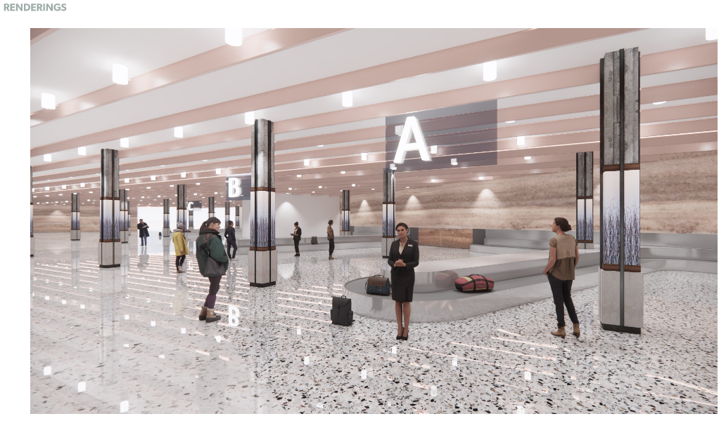
Solution - Rental Car Area and Baggage Return

Slide 25
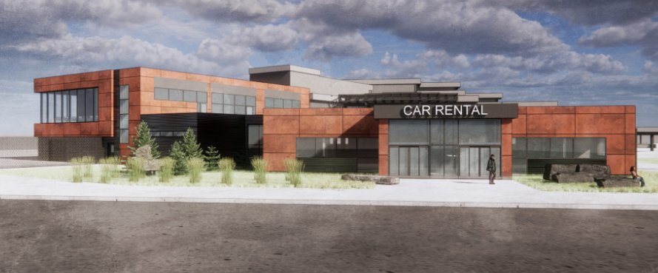
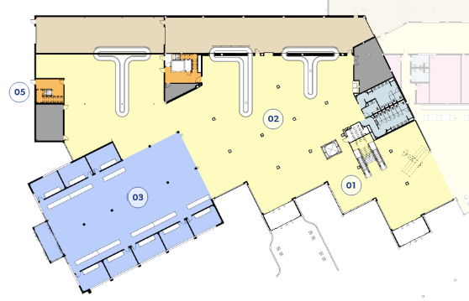
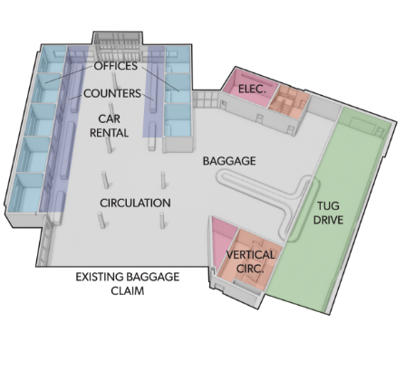
Solution - Rental Car Area and Baggage Return

Slide 26
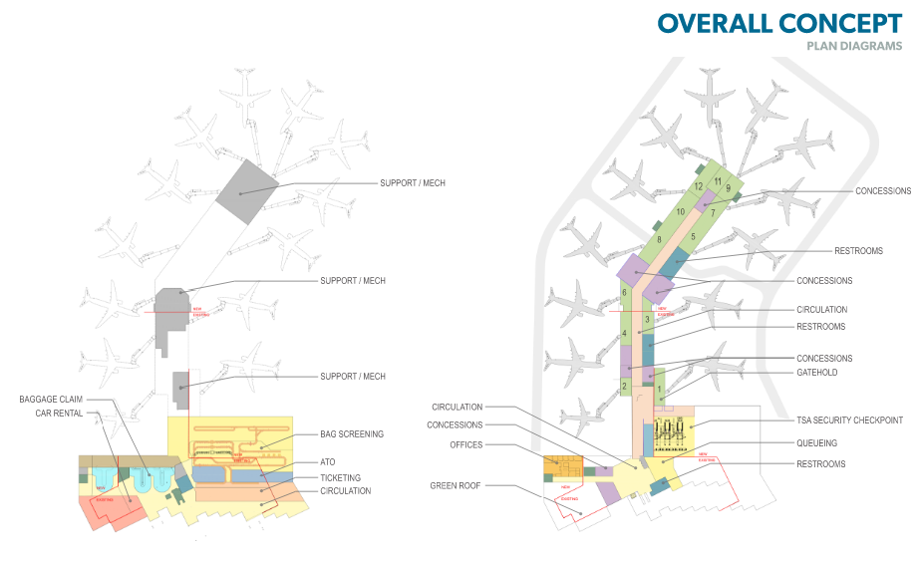
Terminal – Overall Concept
Estimated Cost for the terminal and associated apron - $175-220M

Slide 27
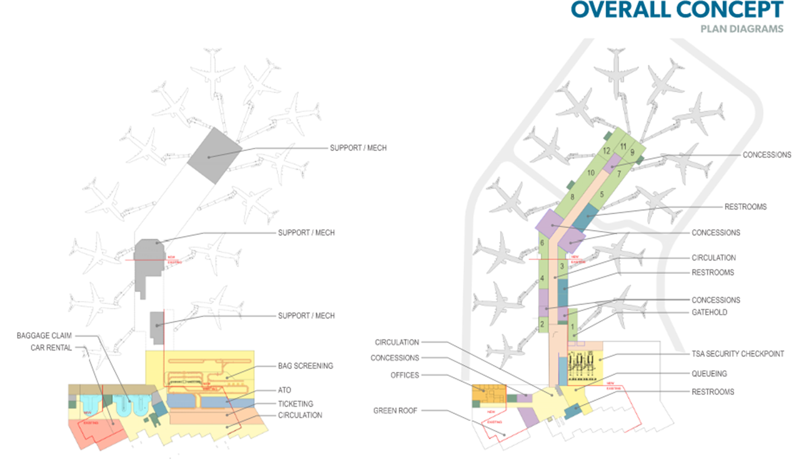
Plan Forward
Maximize airport revenue - Ongoing
  Airport Leadership has grown air service by 32% since 2015
  Airport Revenue has 45% from 2015 to 2019
Break project into smaller pieces to flexibility to accommodate ranges of funding – In Process
Ticketing/ Baggage Makeup
Concourse
Rental Car Area/ Baggage Return
TSA Checkpoint

Slide 28
Plan Forward
Educate Public, Government (City, State, Federal) on project – In Process
  Explain the issues and the solutions
  Listen for new solutions or ways to improve proposed solutions
  Numerous Stakeholder Briefing Have Been Held
Continue coordination of status of project, impacts of delays, seek all possible funding sources, and seek ways to minimize costs.

Slide 29
Thank you.
“When Everything seems to be going against you, remember that the airplane takes off against the wind, not with it.”
Henry Ford, Founder of the Ford Motor Company

