Slide 1



S.D. Highway 1889
Weekly Update
7/29/2026
Weekly Meeting:
Weekly Meetings to be held at AGC Building at 300 E. Capitol Ave, Suite 1. Enter through side door on S. Highland Street.
Time: 11:00 a.m.
Day: Wednesdays
Facebook Live Stream: KCCR Radio
KCCR and DRG will keep you up to date with any traffic changes and progress of the project!

Slide 2
Wednesday, July 29, 2026
All side streets from Wynoka Street to Elizabeth Street are open
Elizabeth/Euclid Intersection is four-way stop
Curb and gutter placement along with grading for asphalt from 1st Street to 4th Street
Two-way traffic on southbound lane from Elizabeth Street to 4th Street
Crossover on north end of project in place to move two-way traffic to the northbound lanes down to 4th Street

Slide 3
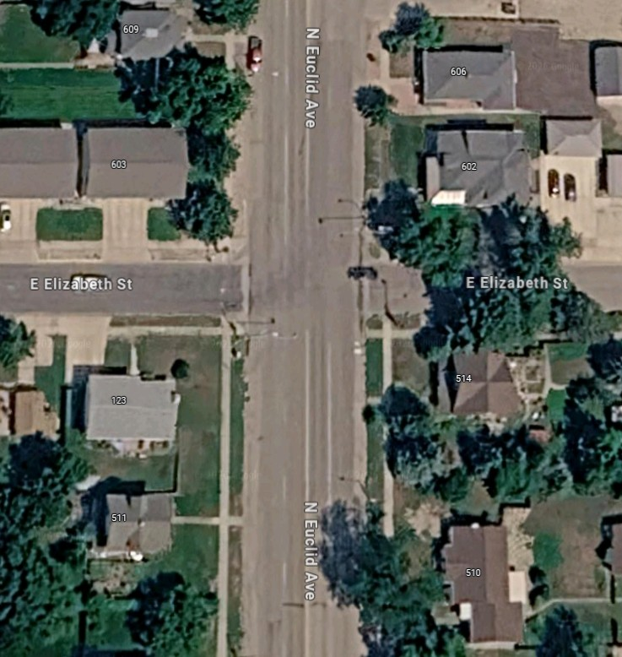
Elizabeth Street will be controlled by four-way stop

Slide 4
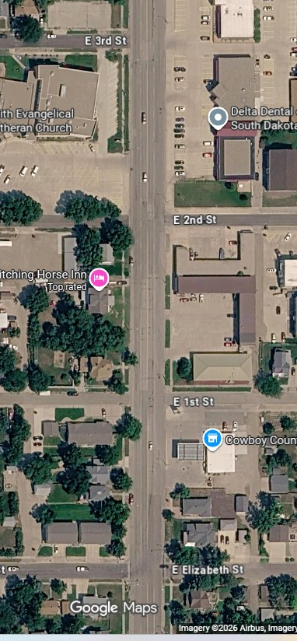
Business will have access from Euclid Avenue
Two-Way traffic will be in the northbound lane
Will not be able to travel east from Euclid Avenue on East 2nd or East 1st Streets

Slide 5
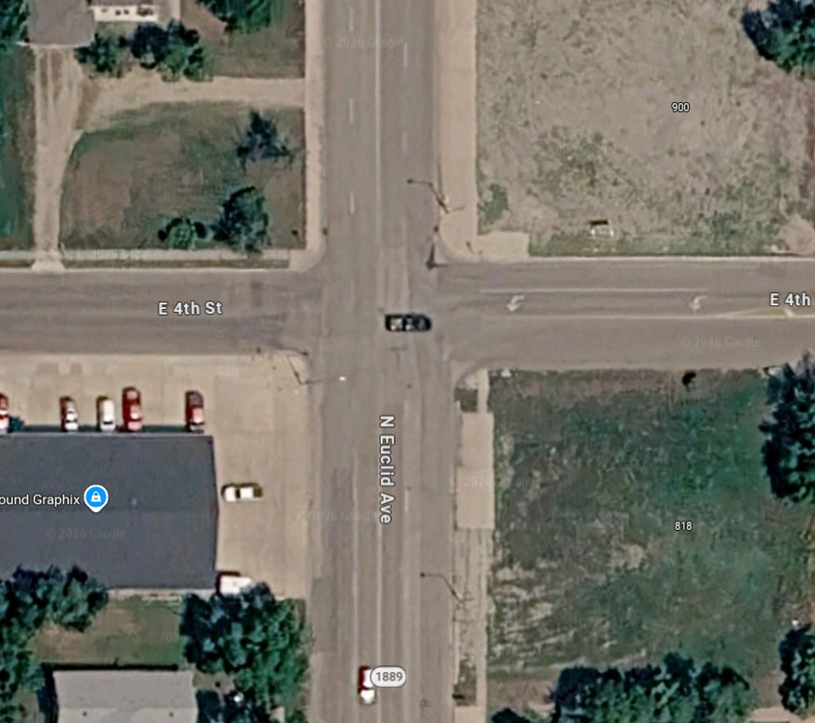
East side of Euclid and 4th is closed
West side of Euclid Avenue and 4th Street is open

Slide 6
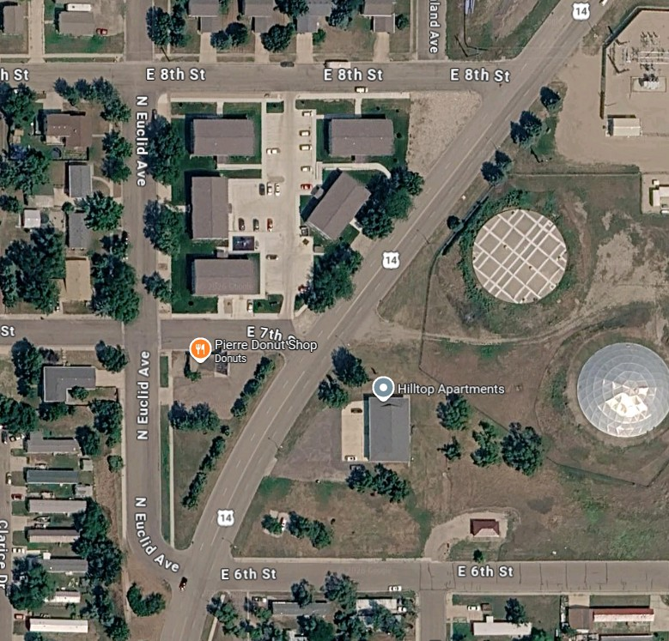
Alternating street closures
as work progresses

Slide 7
Crossover will remain in effect until the end of the project

Slide 8
Expect alternating entrances to business and side streets
4th Street to remain closed between Euclid Avenue and Governors Drive
Elizabeth/Euclid intersection is controlled by a four-way stop
All side streets from Wynoka Street to Elizabeth Street are open
Work is still taking place behind the curbs south of Elizabeth Street
Slow down through work area, be mindful of construction equipment and workers

Slide 9
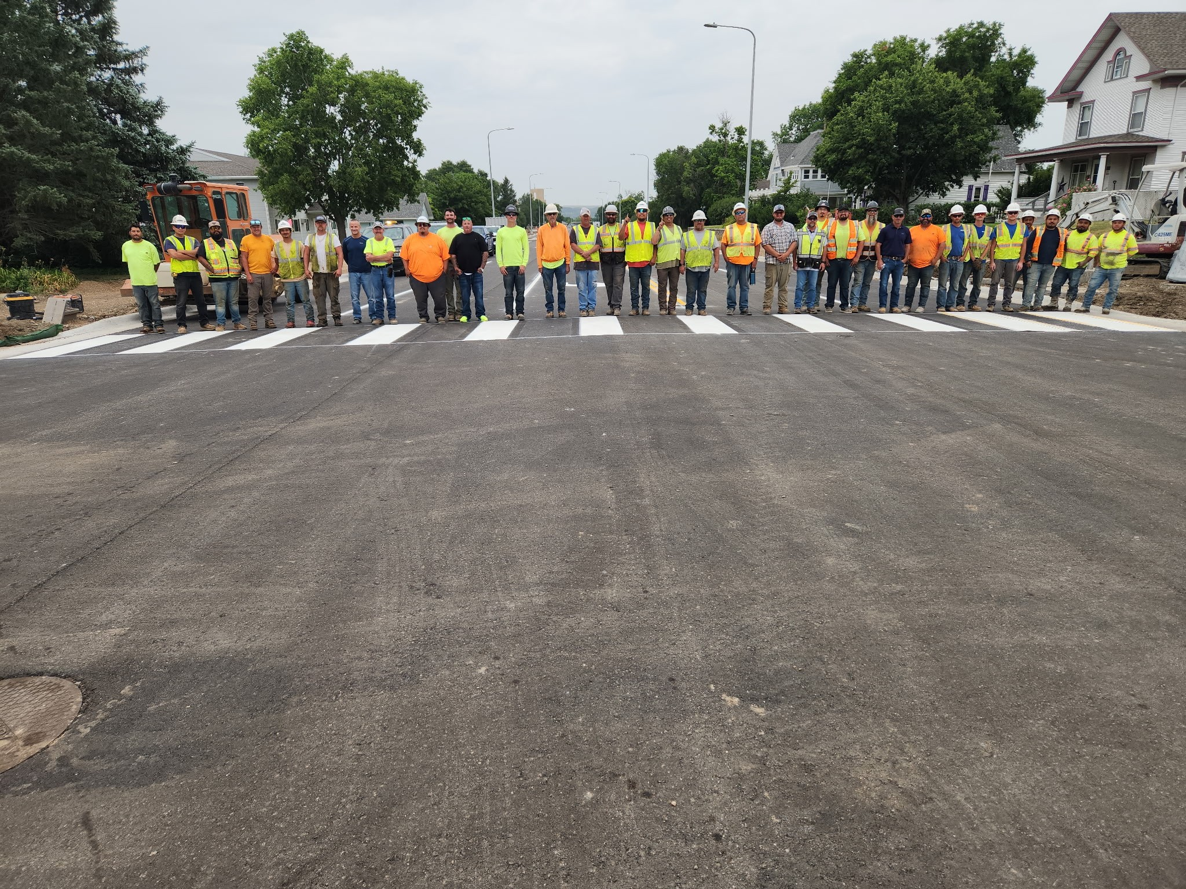

Slide 10

Text Notifications:
For updates on major traffic changes during the project, subscribe to a free text-in service. To subscribe, text “EUCLID" to 605-566-4041. Subscribers can unsubscribe at any time.

