Slide 1
Welcome!
AOPA
Update

Slide 2
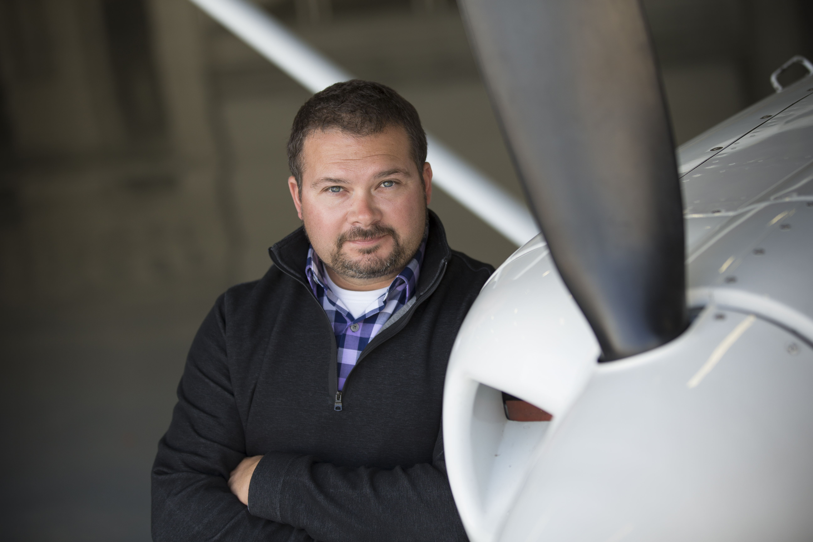
Kyle Lewis
Great Lakes Region Government Affairs and Airport Advocacy
Based in Ohio – JRO
Team of DC Staff and 6 other Regional Managers
Mix of Regulatory, Legislative, Airport Advocacy, and Membership Outreach

Slide 3
MISSION
THE
OF
AOPA
84
WE ARE A
COMMUNITY
300,000+ MEMBERS FLYING 200,000+ GA AIRCRAFT
YEARS YOUNG
GENERAL AVIATION SAFETY
SAFEST YEAR IN OVER 20 YEARS
AOPA FOUNDATION
100% FREE H.S. STEM CURRICULUM
22% FEMALE 49% MINORITIES
ADVOCACY
TRAINING, TECHNICAL SUPPORT

Slide 4
State of GA
Simply stated, the skies have never been busier. The past few years have shown the advantages and flexibility of GA to individuals and businesses
GA operations around the country have exceeded pre-COVID levels. Up almost 30% (FAA top 77 airports).
Student, Commercial, and Private Pilot Certificate numbers have all increased over the past four years!
Flight schools are busy. AOPA Poll: Nearly 60% of schools say business is stronger than pre-COVID-19
GAMA reports increases in helicopter and piston deliveries; try finding a used aircraft for sale!

Slide 5
400+
43
SCHOOLS
STATES
45,000+
FREE
STUDENTS SERVED
STEM Curriculum provided to all schools for all four HS grades
22% female
49% from minority backgrounds

Slide 6
Kimball High School
Kimball, SD
Lake Preston High School
Lake Preston, SD
CTE Academy
Sioux Falls, SD
Marty Indian High School
Marty, SD

Slide 7
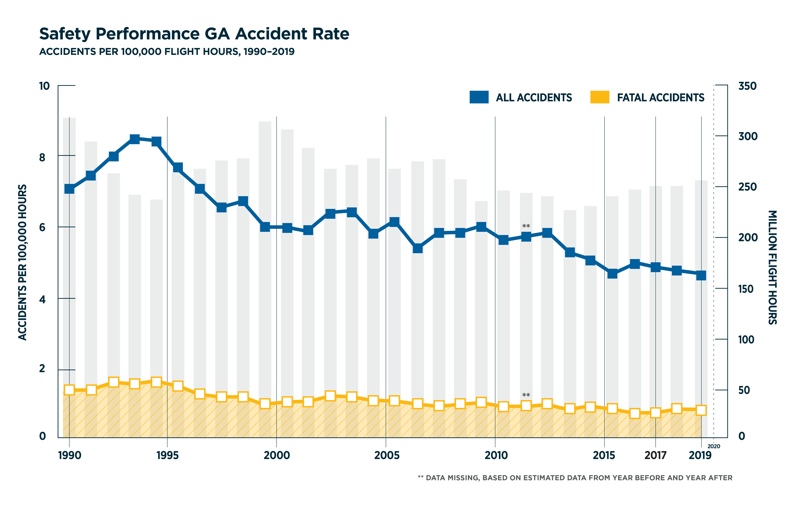
Safety Performance
General aviation has never been safer
According to FAA data, general aviation had its safest fiscal year
ASI continues to offer vital content to help keep pilots safe

Slide 8
2023 AOPA Sweepstakes Cessna 170B
180 horsepower engine
Big backcountry tires
Modern VFR instrumentation
Lightweight interior
Dramatic, Backcountry paint scheme
Find project updates and a list of contributors at www.aopa.org/sweeps
8

Slide 9
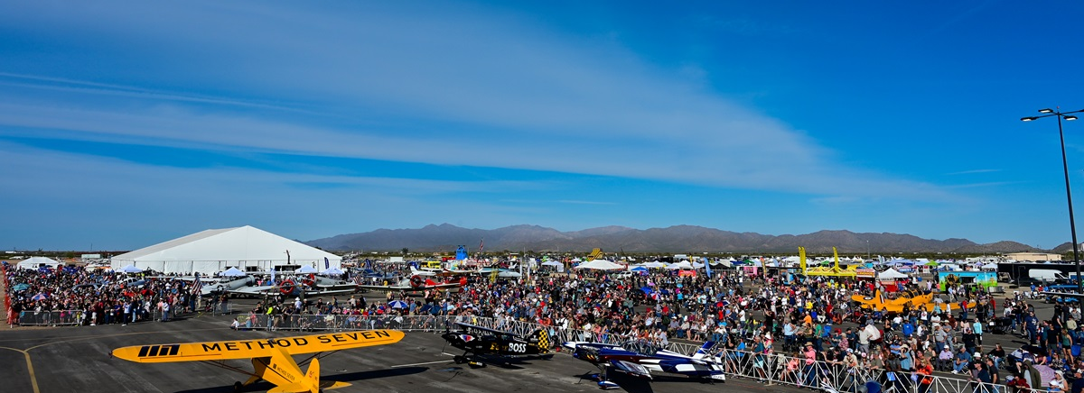
AOPA Events – Fly Ins
Co-Existing Events & Aviator Showcases
85th Anniversary in 2024

Slide 10
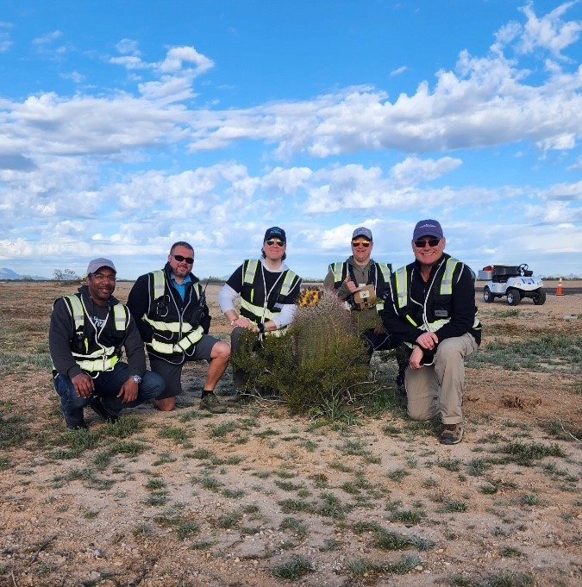
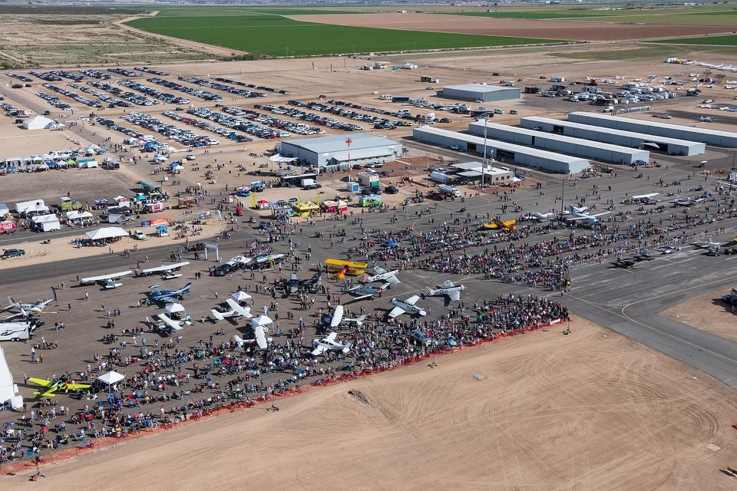

Slide 11
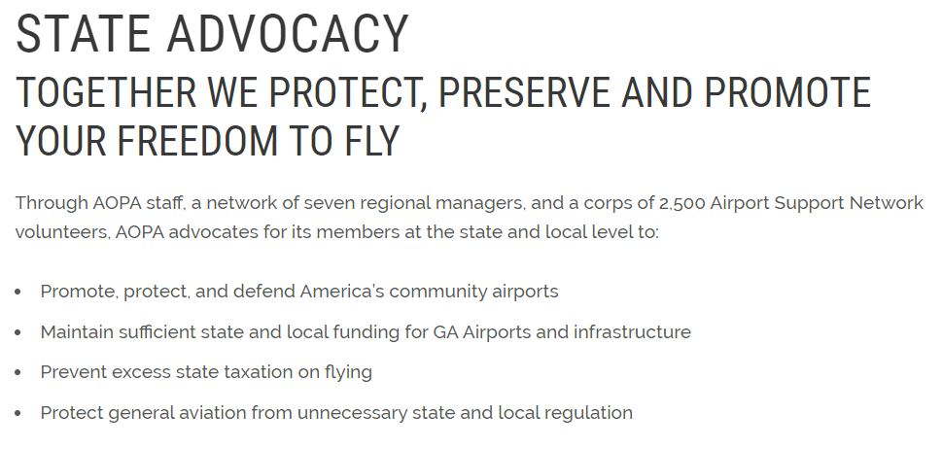
AOPA ADVOCACY
Airports and State Advocacy – AOPA Government Affairs
Airport Policy Manager – DC Based for Direct FAA Contact
7 Regional Managers (including Alaska)
State Legislative Affairs
Airport Advocacy / ASN
Membership Outreach

Slide 12
AOPA named a top advocacy
association
Protecting and promoting GA and local airports
(hangars, access, encroachment)
Know Before You Go
Transparency Focus on GA Ramps and FBO Fees (including Signature and Atlantic)
SUPPORTING ORGANIZATIONS
Insurance fighting on behalf of seasoned (and safe!) pilots
8
YEARS IN A ROW
300+
Avgas AOPA leading the charge toward a lead-free GA future
Five-year anniversary of BasicMed providing a more efficient way for 70,000+ safe pilots to get medical
Protecting
Flight
Training from misguided FAA directive
Real-time MOA/SUA notifications saves aviators time and money

Slide 13
Airports 101
Public vs Private
Public use vs Private use
Primary vs Non-Primary
Commercial, Reliever, or General Aviation
NPIAS or non-NPIAS
Unclassified, Basic, Local, Regional or National
Sponsor: Commission, Authority, County, City
Notes:
Sponsors need to know more about how their airports “work”
Purpose of this Seminar
Introduce Sponsors and Members to the “language” of Airports
Help you understand the world your Airport Manager lives in
Provide the knowledge to help you UNDERSTAND your airports
Arm you with the tools to IMPROVE your airport
This Seminar is merely an Introduction to the “business” of airports and only introduces a few terms and FAA programs. There is considerable depth to this business, so this short seminar provides the “50,000 foot” perspective.

Slide 14
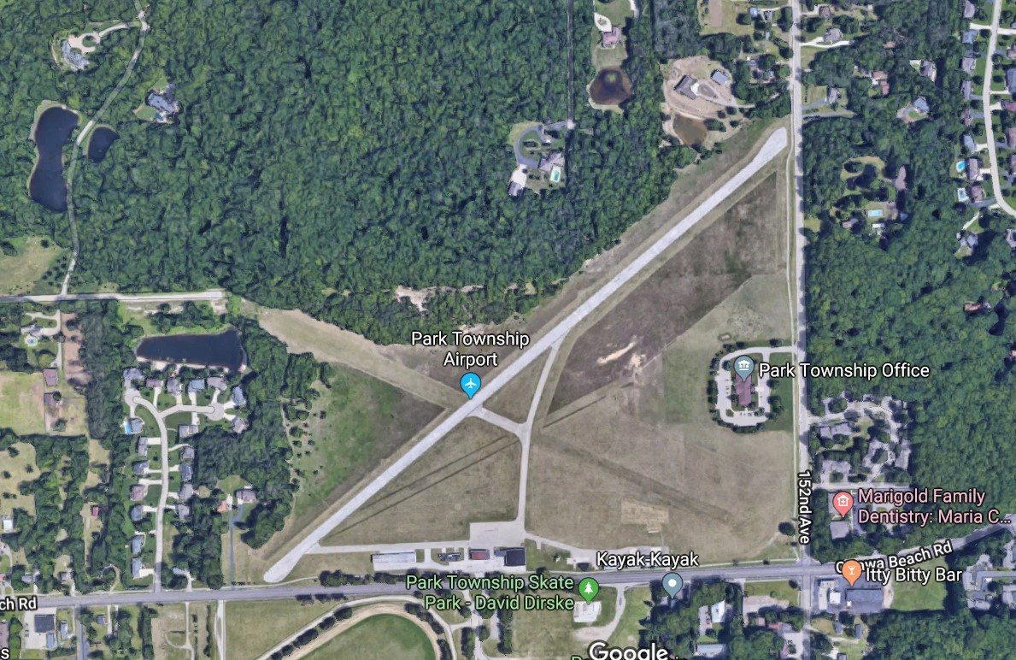
How Many Airports?
19,624 Landing Facilities in the US – Public and Private Combined
14,457 Privately Owned
5,099 Public Use Airports
4,861 Publicly Owned Facilities
3,321 Eligible for Federal AIP Funding
2,941 Are GA Community Airports
380 Commercial Service Airports
306 Military Facilities

Slide 15
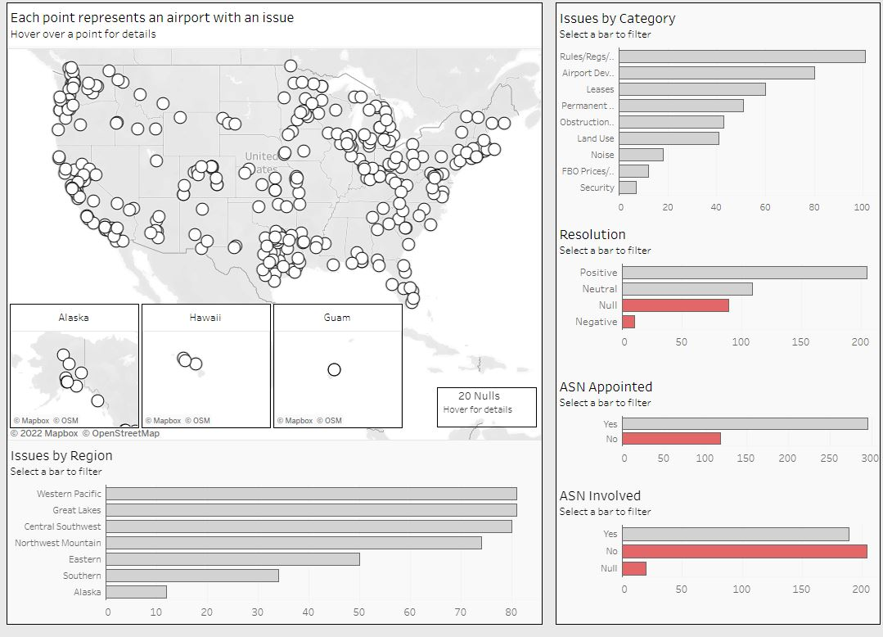

Slide 16
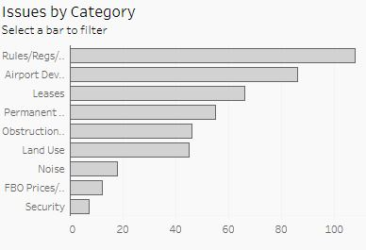
Top Airport Advocacy Issues
Airport Rules
Airport Development
Leases
Closure

Slide 17
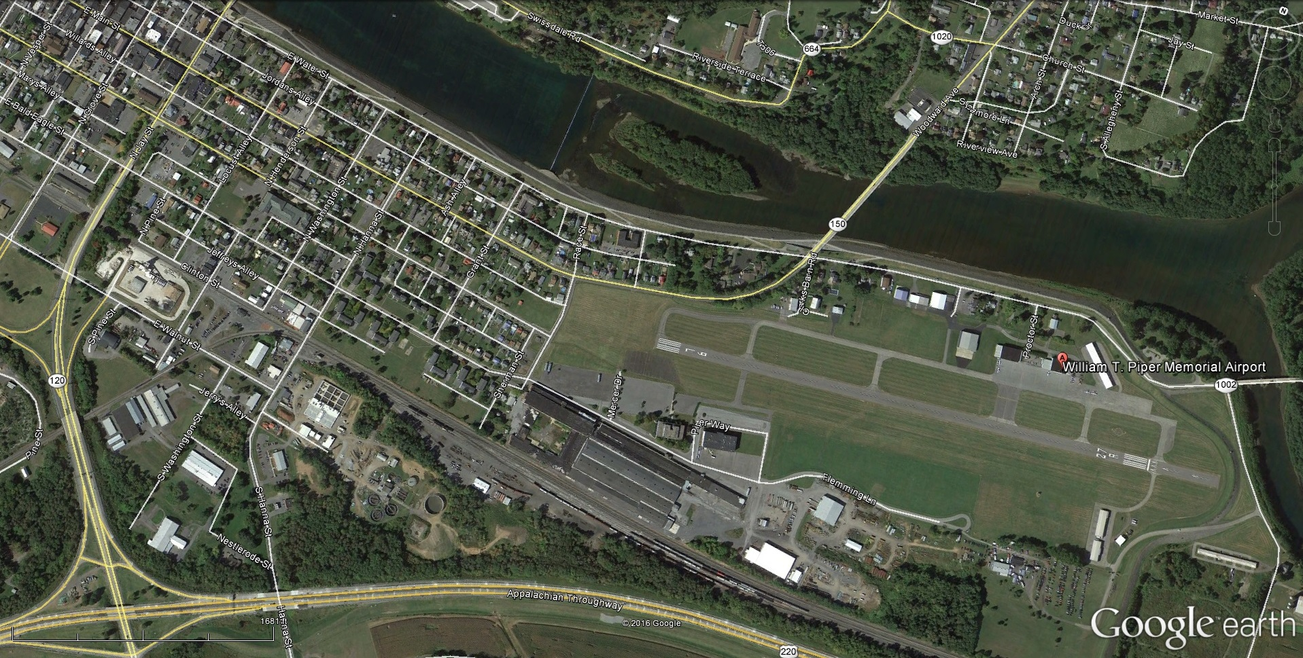
External Advocacy Issues
Public-Use Community airports – whether publicly or privately-owned face challenges
Noise Complaints
Urban Sprawl
Zoning
Political Pressure
Obstructions
Public “Perceptions”
Notes:
Next few charts will address some of the common problems we see at airports
We are currently working 95 active “cases”

Slide 18
Leases
Review for FAA Compliance
Land-Lease vs. Usual Rent Arrangement
Reversion Reversion Reversion !
Insurance Requirements
Grant Assurances – Number 22 Economic Non-Discrimination

Slide 19
Airport Advocacy in the Region
Burke Lakefront Closure Threat
Detroit City Airport – ALP Approval
Monitoring 100LL Concerns

Slide 20
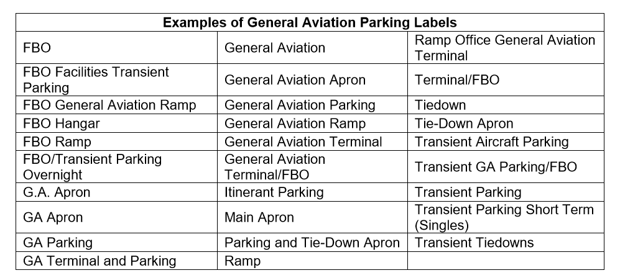
Charting and Airport Diagrams
Adopted into Airport Sign Systems AC150/5340-18
GA Transient Apron – An apron where itinerant general aviation operators can park their aircraft without FBO services and subject to terms and conditions.
FBO Apron – Ramp controlled by a commercial FBO entity OR sponsor if municipal run FBO (inherent associated fees)
GA Tenant Parking – Parking area for based aircraft (subject to leased tie down or hangars)

Slide 21
X-wind Runway Advocacy
Sustainability When Not Eligible
Other Airport Improvements
Local Dollars for Maintenance and Rehab / Obstruction Removal – Millions!
When Promulgated by Noise Complaints
Non-Transparent Process
The Runway Meets FAA Funding Eligibility
No Compelling Safety Data Requiring Crosswind Runways

Slide 22
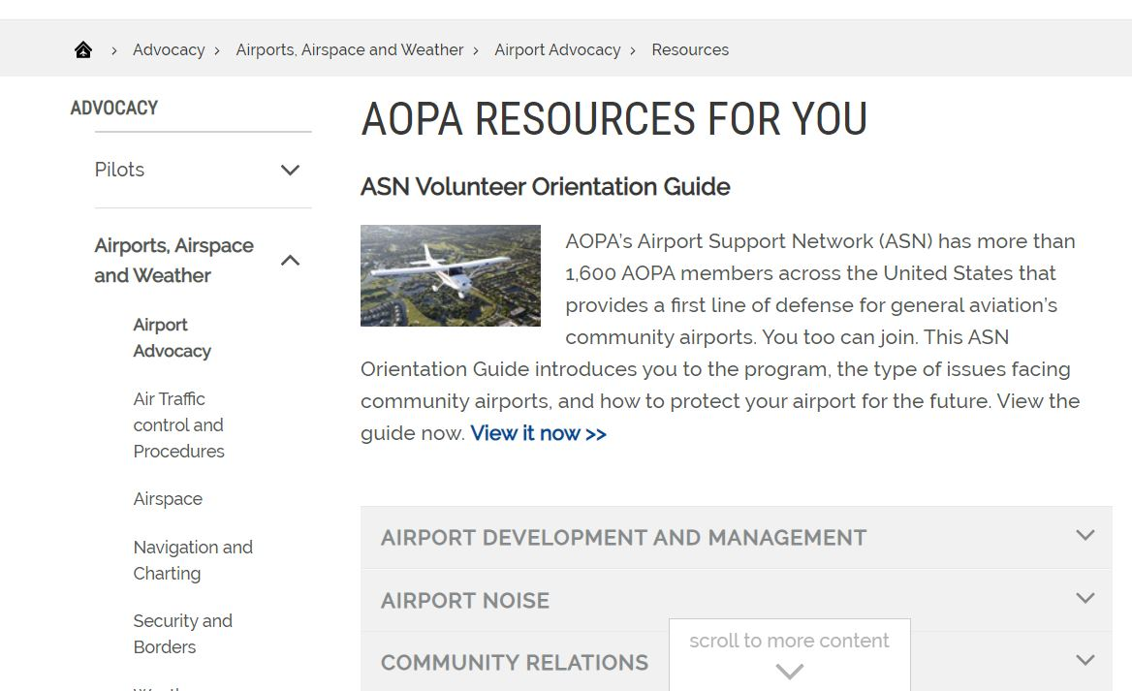
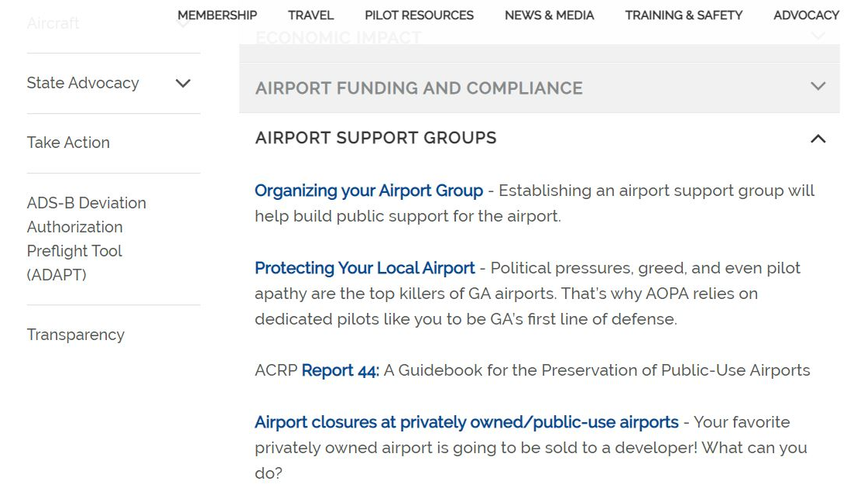
aopa.org/asn

Slide 23
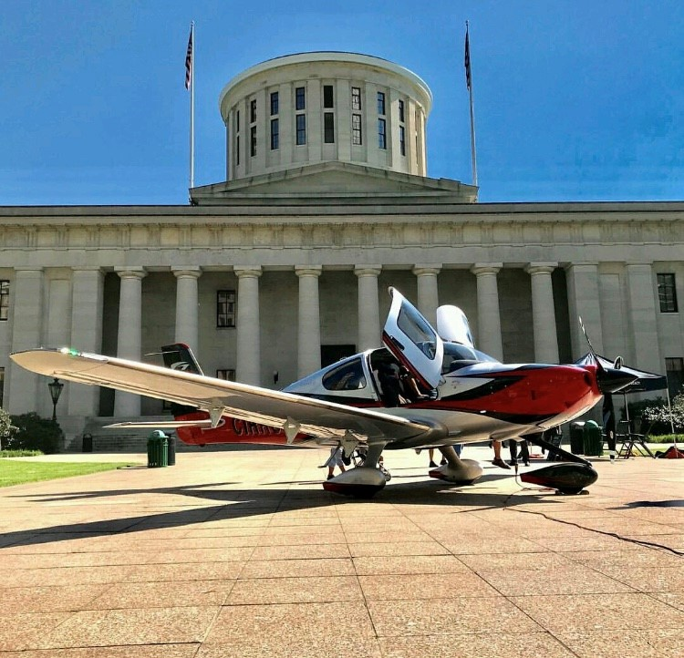
Federal Outlook
NCAA – National Center for the Advancement of Aviation
FAA Reauthorization – 2023
GA Caucus – 200+ House Members and 29 Senate Members
T&I Chairman Sam Graves (R-MO)
Senate Co-Chair is Sen. Joe Manchin (D-WV)
Regional State Legislative
Ohio – Airspace and Airport Protection (Tall Structure Permits)
Indiana – Match Reduction for State Direct Grants (50% - 25%)
Michigan – Aeronautics Code Updates
Minnesota – Appropriations – Aviation Funding

Slide 24
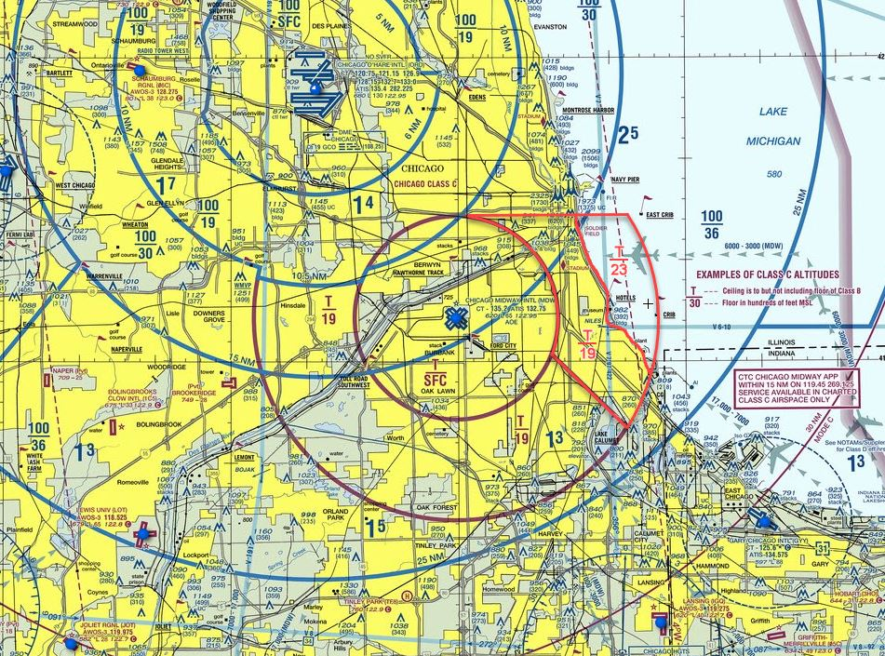
MDW Class C Redesign

Slide 25
Getting the Lead Out
The EAGLE Initiative
Group of dedicated organizations aligned on a smart transition to unleaded aviation fuel
Email: 100UL@aopa.org

Slide 26
Issues Affecting Continued Availability of 100LL
Santa Clara County nixes leaded fuel at Reid-Hillview Airport, considers early closure
Over FAA’s objection, Santa Clara County’s airports will switch to unleaded gas for small planes
The move could potentially bring the withholding of federal funds
Santa Monica Airport (SMO), Leaded Avgas, and Childhood Blood Lead Levels: Profound Pediatric Health Consequences

Slide 27
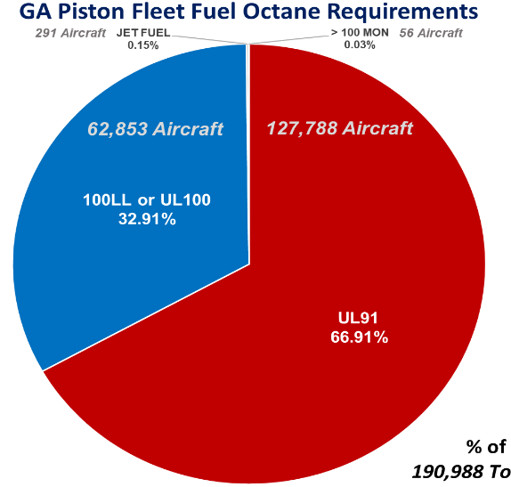
Unleaded Avgas Transition: Key Issues
Estimated
126M gal/year
70% of avgas
Maintain Safety of Existing Fleet
High-Performance Engines/Aircraft Require 100 Octane for Detonation Protection
100LL
32.9% of aircraft
UL91/94
66.9% of aircraft
Estimated
54 Mgal/year
30% of Avgas

Slide 28
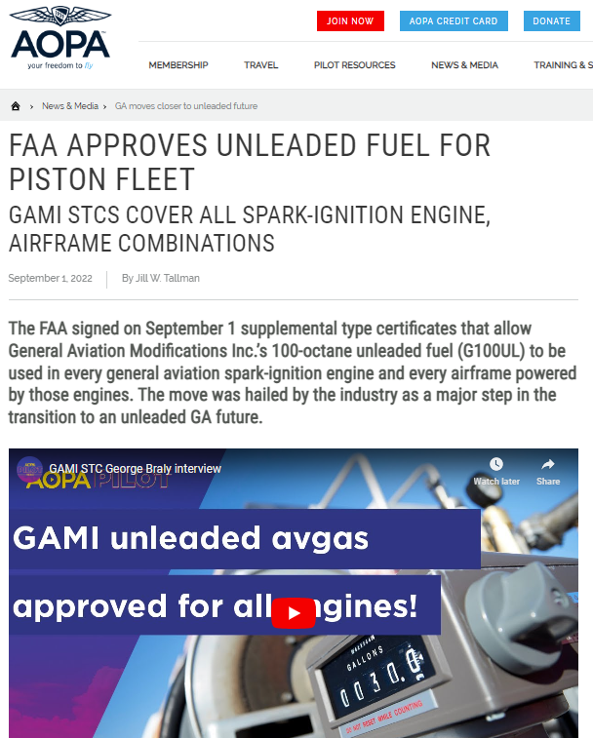
Unleaded Fuel - Progress
FAA granted STC approval for GAMI's G100UL for vast majority of piston aircraft
GAMI working through commercialization to bring to airports
Swift anticipates unleaded 100R STC approval in 2023
Some lower-compression aircraft can use its 94-octane UL
Two fuels in testing under the FAA’s PAFI program, and showing promise
Stay informed and engaged at www.aopa.org/100UL

Slide 29
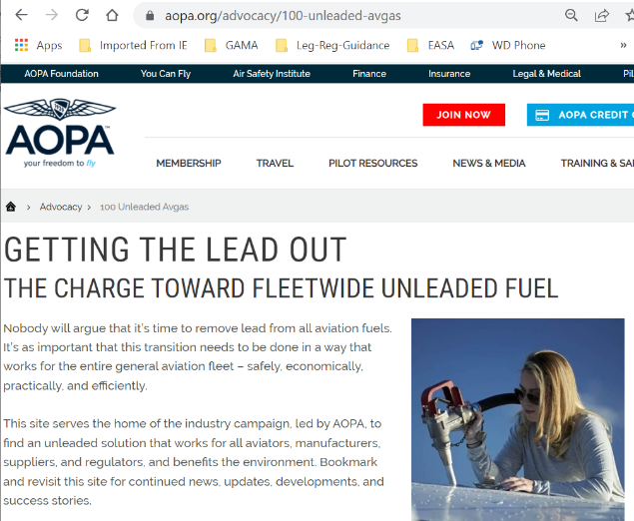
Fueling the Future: Stay Engaged
Collaborative
FAA/Industry Initiative
Urgency & Priority
Chart Our Own Roadmap
Protect Availability of 100LL
Minimize Impact

Slide 30
Kyle Lewis
Regional Manager Government Affairs & Airport Advocacy
kyle.lewis@aopa.org
301-695-2229

