Slide 1
Public Meeting
NH 0046(69)288 PCN 05JN
SD Highway 46 in Wagner
March 24, 2020 (Virtual)
August 13, 2020 (National Guard Armory)
July 19, 2021 (City Council Chambers)
Jay Peppel, PE
Area Engineer
November 4, 2021

Slide 2
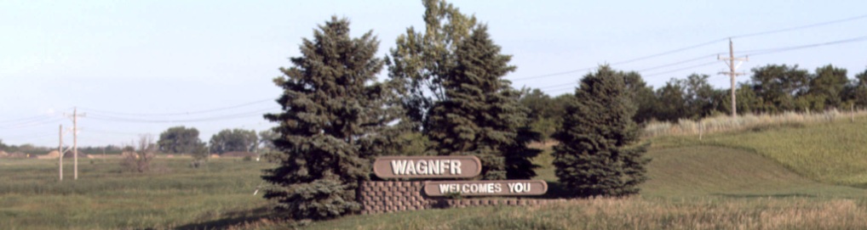
Purpose of the Meeting
Present Current Proposal
Discuss Comments Received
Gather Additional Comments

Slide 3
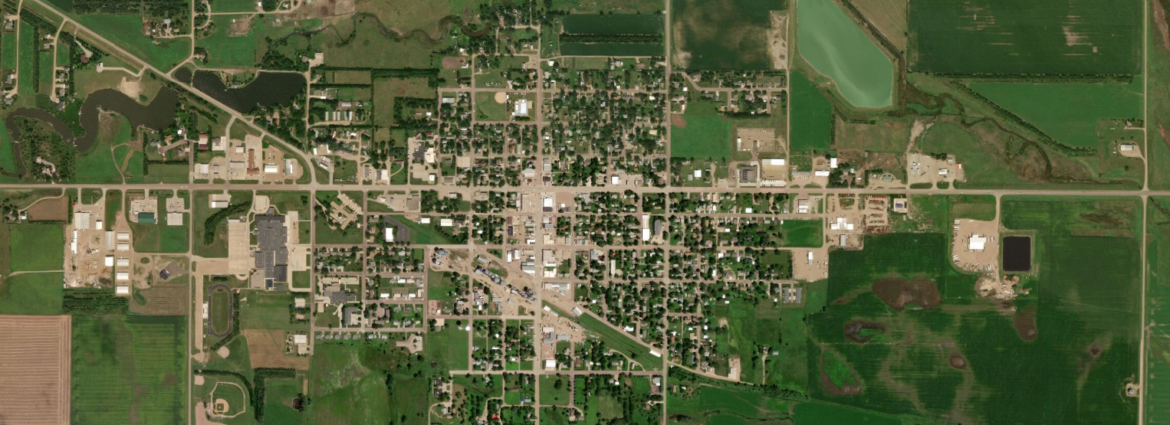
Project Limits
F
Begin Project
End Project
Main Ave
Front Ave
High Ave
SD Hwy 46
Walnut Ave
Wagner

Slide 4
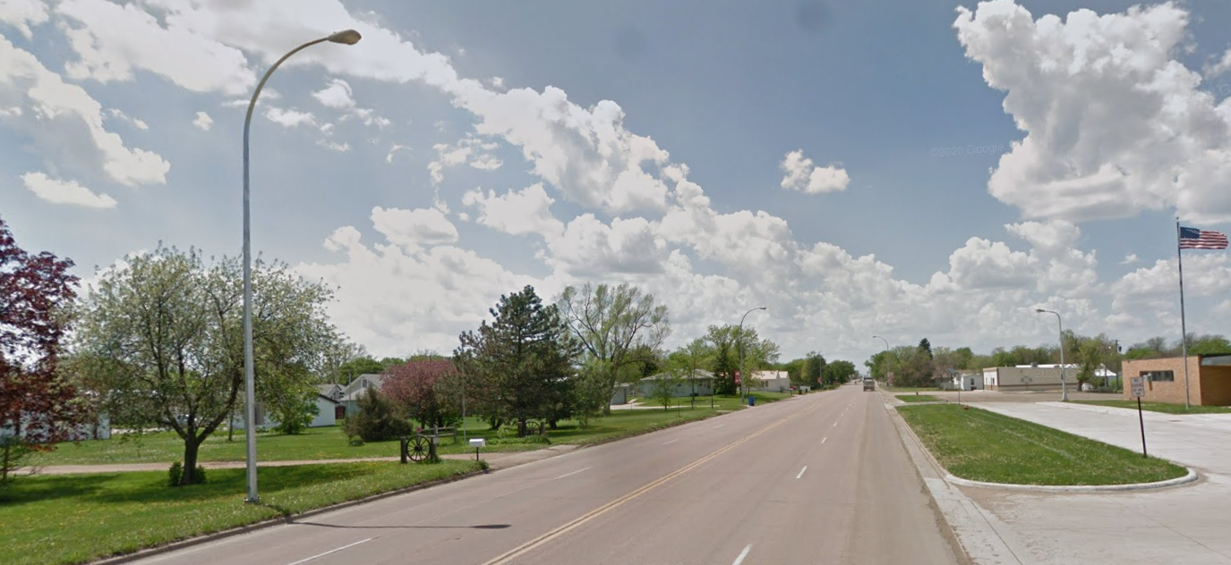
Why We Are We looking at an improvement project on Hwy 46
Improve Safety
Poor Pavement Condition
Improve Drainage
Need Pedestrian /ADA Facilities

Slide 5
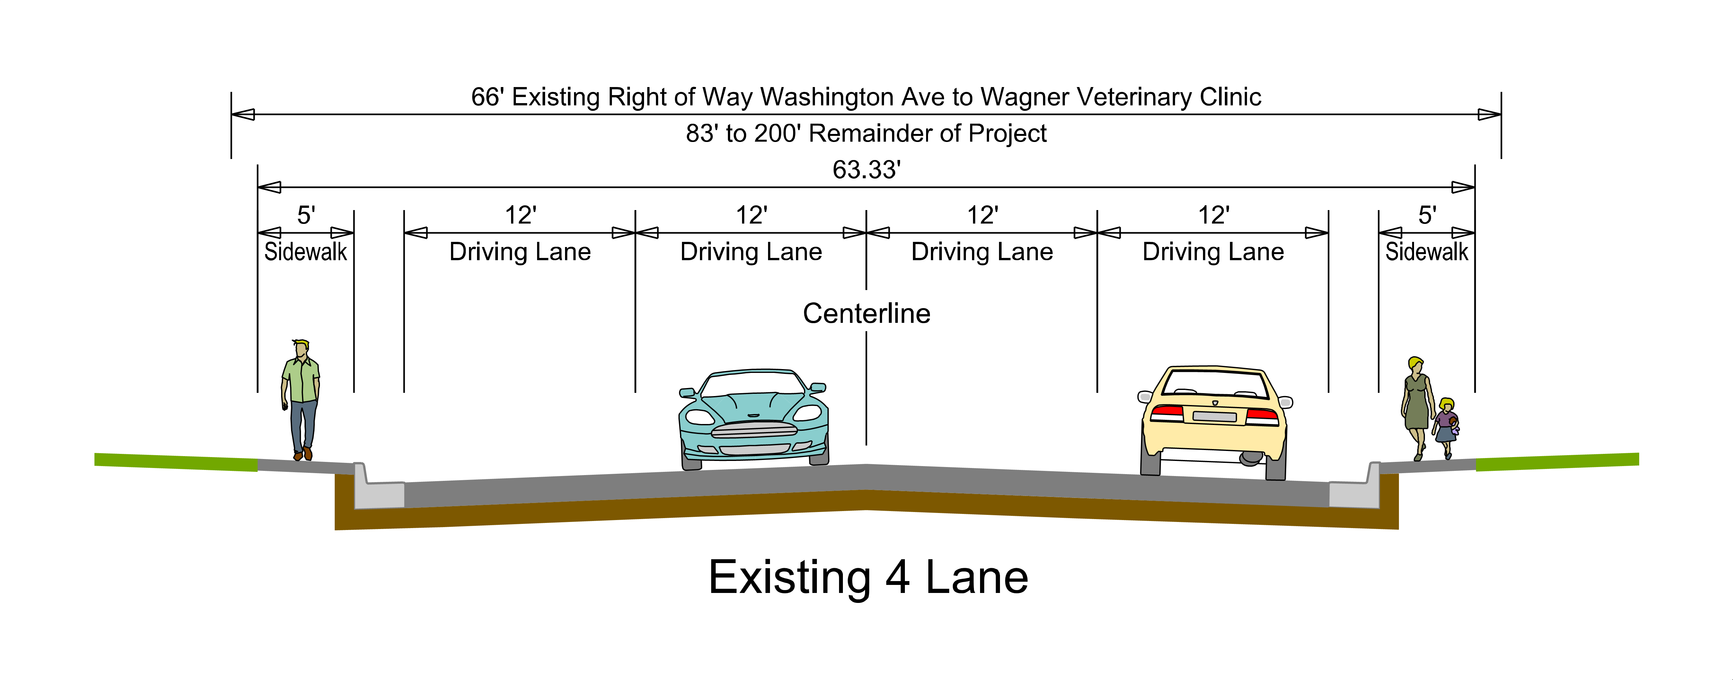
Existing Typical Section

Slide 6
Proposed Improvements
Modify 4 Lanes to 3 Lanes with Two Way Center Turn Lane
Add Sidewalks
New Storm Sewer
Roadway Lighting
Traffic Signals
Portland Cement Concrete Surfacing

Slide 7
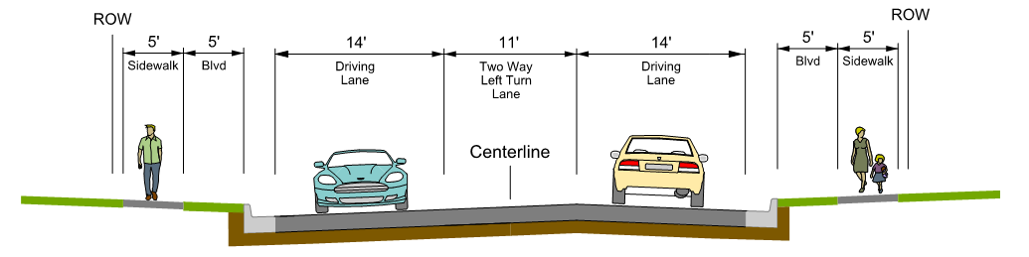
Proposed Typical Section
3 Lane Section
  2-14’ Outside Lane
  1-11’ Two Way Left Turn Lane
  Curb & Gutter
  Concrete Surfacing

Slide 8
3 Lane Roadway Advantages
Traffic analysis – Greatest benefit/cost ratio
Provides safe storage for left turning vehicles
Reduces the number of conflict points for left turning vehicles and vehicles entering the roadway
Reduces the speed differential between vehicles
Boulevard provides separation between vehicles and pedestrians for increased safety
Reduces crossing width for pedestrians
Boulevard provides snow storage during winter so sidewalks can stay clear for pedestrian use

Slide 9
Comparable Communities to Wagner
4 Lane to 3 Lane Conversion
HW 12 – Milbank (2013) – Similar Traffic Volumes
HW 14 – Miller (2013) – Similar Traffic Volumes
HW 12 – Ipswitch (2012) – Similar Traffic Volumes

Slide 10
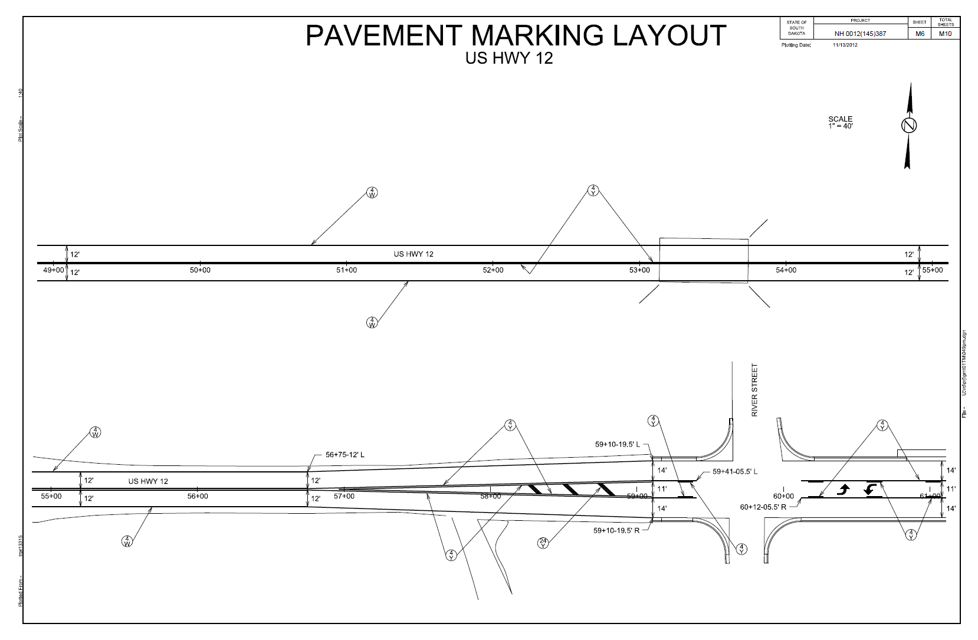
HW 12 Milbank

Slide 11
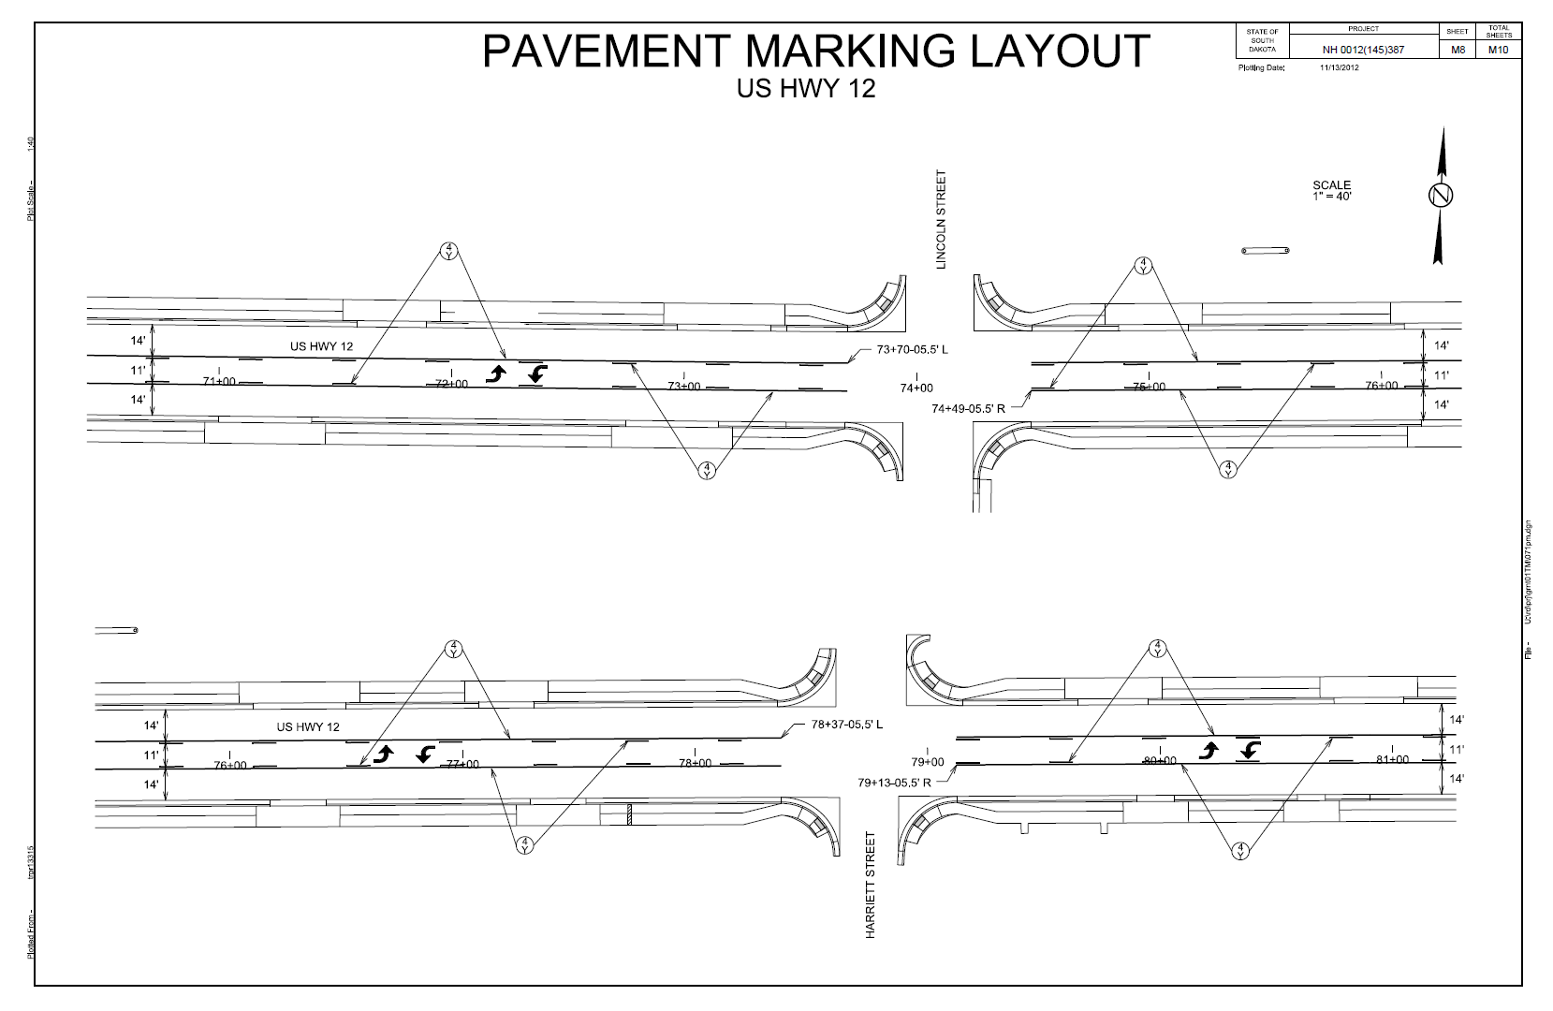
HW 12 Milbank

Slide 12
Construction Duration
2 Years
Year 1 – Main St to East End of Project
Year 2 – West End of Project to Main St
Open to Traffic
Phased Construction
Business Location Signs
2.1 Mile Project Length

Slide 13
Crash Data
  12 Reported Crashes
    4 Intersection Crashes
    3 Rear End Crashes
    2 Side Swipe Crashes
    3 Other types Crashes
  0 Fatalities
  4 involved injuries
  Reported Crash Rate = 1.16
  Statewide Weighted Crash Rate = 1.92 (crashes per million vehicle miles of travel) 2015 through 2019
5 Year Period
2016 to 2020
Urban Principal Arterial
FHWA Strategic Objective #1: Save lives by expanding the use of data-driven, systemic safety management approaches and by increasing the adoption of proven safety solutions by all road owners.

Slide 14
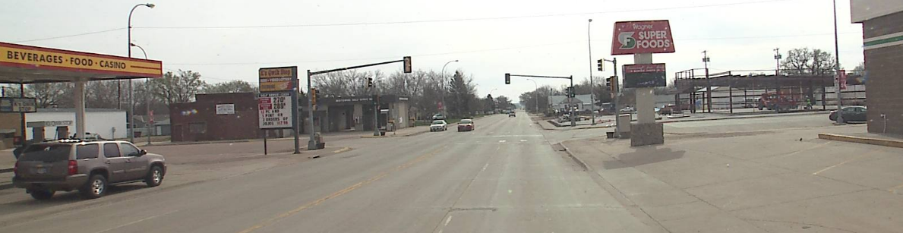
Crash Data – 4 Lane vs 3 Lane
All crash types: 31% reduction
Fatal/Injury: 37% reduction
Property Damage: 28% reduction

Slide 15
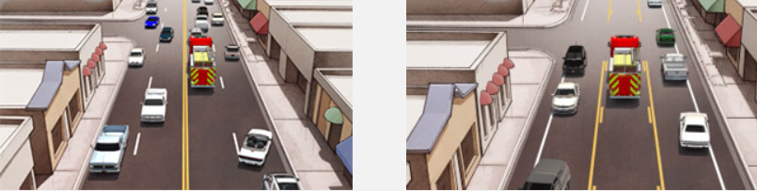
Emergency Vehicle Transit
To provide safe, efficient access to streets and highways
Limit number of direct accesses to major roadways
Improved Emergency response time
SDCL 32-26-15 – Yield to emergency vehicle

Slide 16
Traffic
    2019 ADT = 4,510
    2044 Projected ADT = 6,990
    Truck Traffic = 5.6%

Slide 17
Traffic Counts
    * Actual traffic data provided in handout

Slide 18
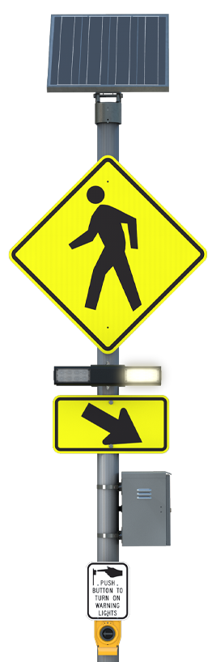
Pedestrian Crossings
To provide safe, efficient access to streets and highways
Limit number of direct accesses to major roadways
Reduced pedestrian Crossing Width
Marked crosswalks
  Existing at Walnut, High and Main
  Proposed at Sheridan
Rectangular Rapid Flashing Beacon
Proposed at Walnut and Sheridan

Slide 19
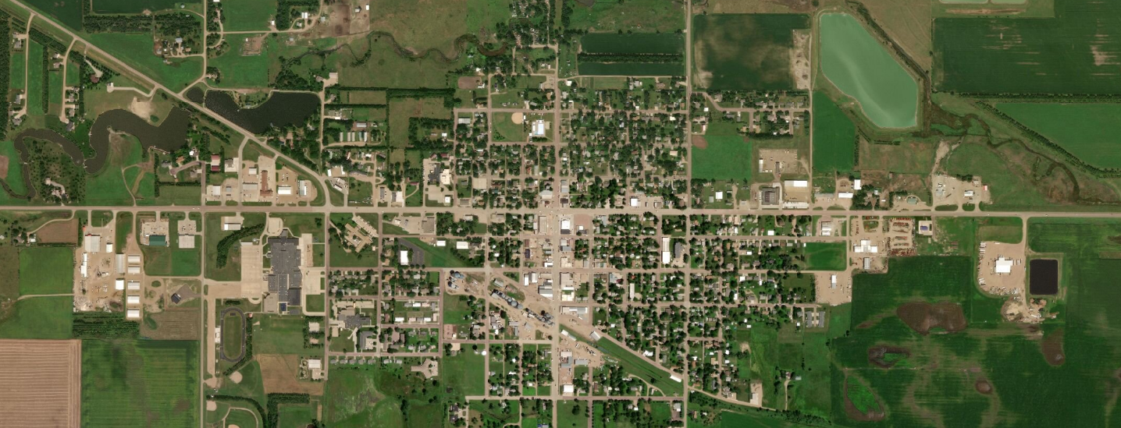
Extend Pedestrian Facilities
Main Ave
Valley
Pump &
Casino
Family
Dollar
High Ave
Front Ave
Wagner
Building &
Supply
394th Ave
Walnut Ave
Sheridan Ave
Existing: Walnut to Front Ave and Nat Grd Armory
Planned: Wagner Building & Supply and 394th Ave to Valley Pump & Casino

Slide 20
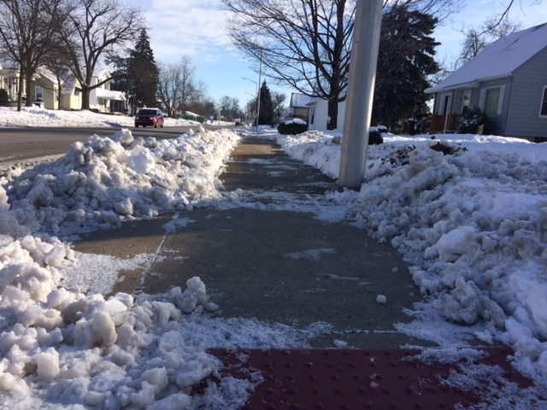
Pedestrian Facilities
Boulevard Snow Storage
14’ lane provides Separation

Slide 21
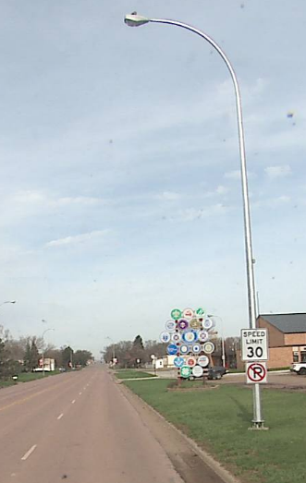
Roadway Lighting
Replace Existing Lighting
  LED

Slide 22
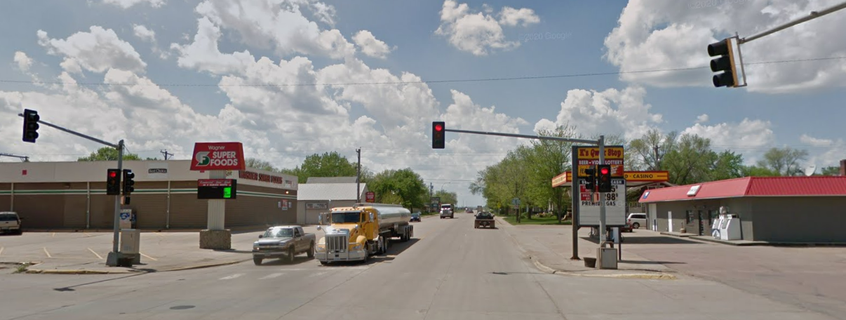
Traffic Signals
Traffic Signal at SD46 & Main Street will be replaced

Slide 23
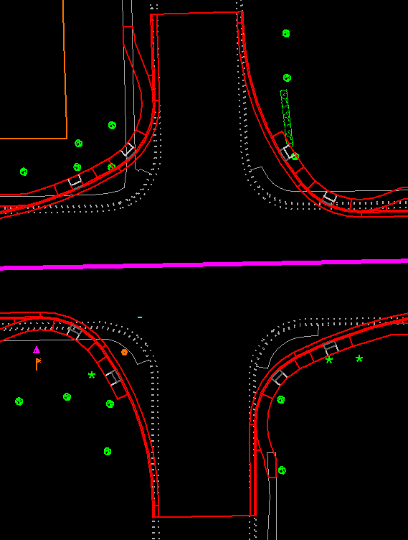
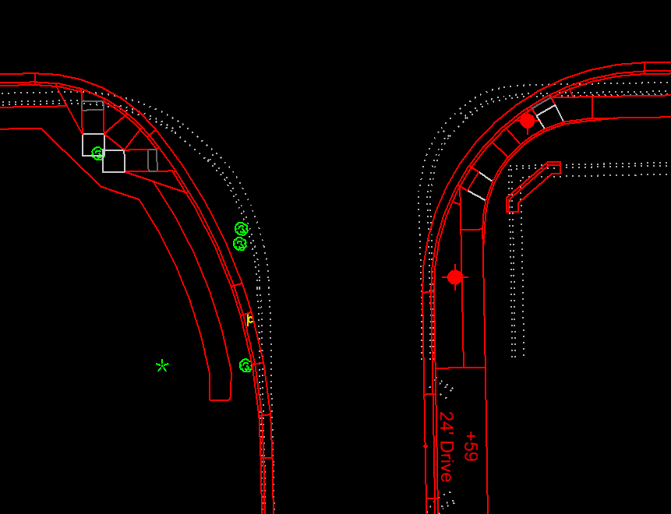
Increased Truck Turning
SD Hwy 46
SD Hwy 46
High Ave
Front Ave
Accommodates semis with 53’ trailer

Slide 24

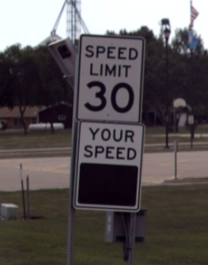

Traffic Speeds
To provide safe, efficient access to streets and highways
Limit number of direct accesses to major roadways
Wider lanes can encourage increased speeds¹
Post construction, review and adjust
Existing Radar Feedback Signs
¹ FHWA, Road Diet Informational Guide, 1st Edition, 2014

Slide 25
Tentative Project Schedule
3 Lane Configuration
Winter
2021
Final Design
2022 thru
2023
ROW Acquisition
2024 & 2025
Construction
Estimated Cost: $11.3 million

Slide 26
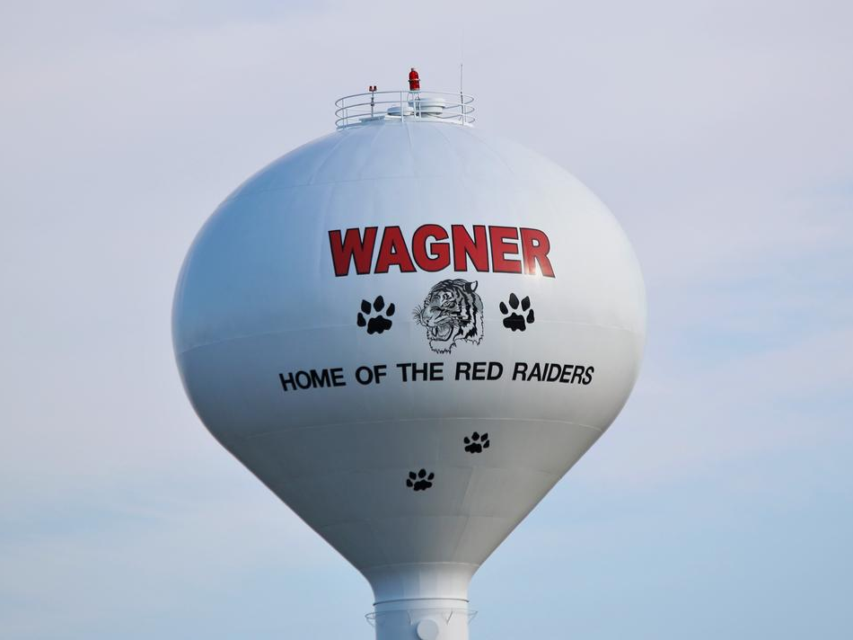


Public Input
Please Submit Questions or Comments by
November 18, 2021 to:
Neil Schochenmaier
South Dakota Department of Transportation
700 East Broadway Avenue
Pierre, SD 57501
Neil.Schochenmaier@state.sd.us
Public Meeting Information can be found at:
https://dot.sd.gov/projects-studies/projects/public-meetings

Slide 27
Comments Received
Two years of construction will kill the businesses in Wagner

Slide 28
Comments Received
Our crash data is well under the statewide average so why do we have to change?

Slide 29
Comments Received
Oversized equipment will have trouble due to the decreased pavement width – houses, farm equipment, slow moving vehicles, etc…

Slide 30
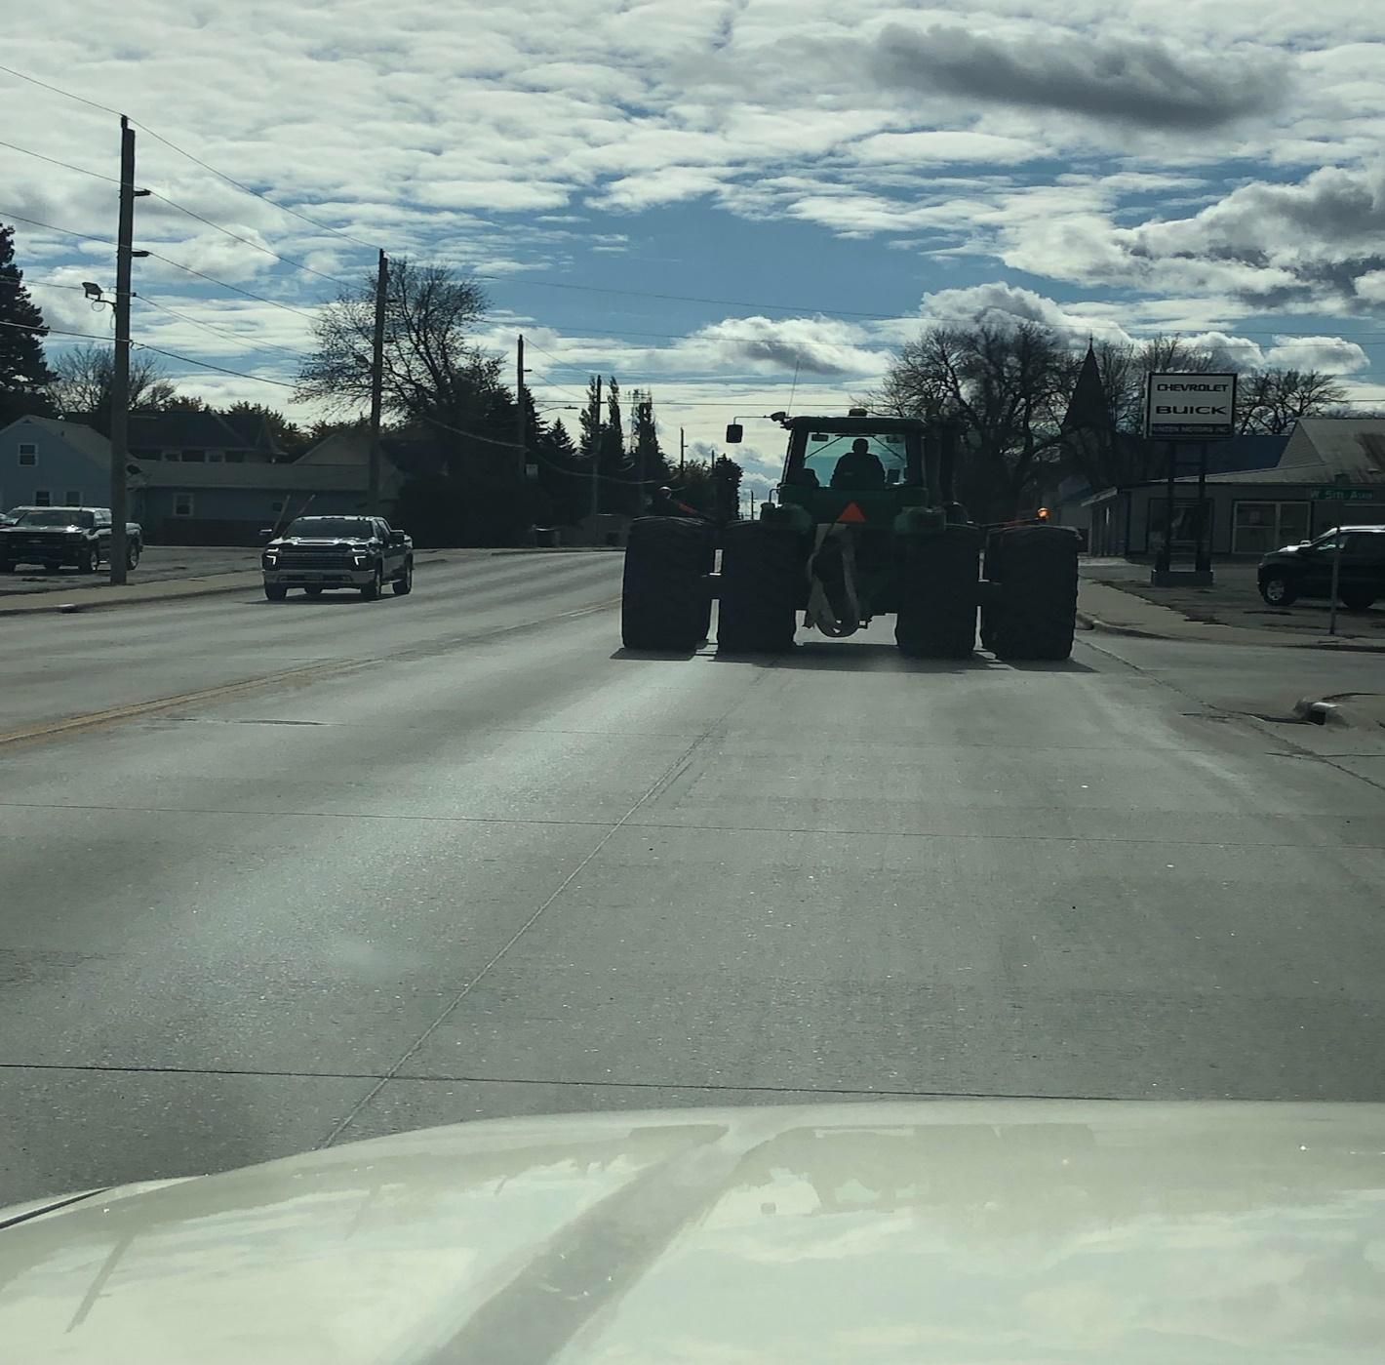
Comments Received

Slide 31
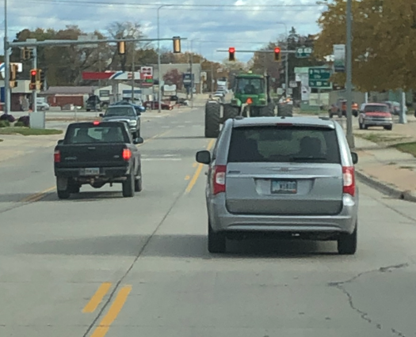
Comments Received

Slide 32
Comments Received
Emergency Vehicles will have trouble getting through town with the 3 lane.

Slide 33
Emergency Vehicle Transit
To provide safe, efficient access to streets and highways
Limit number of direct accesses to major roadways
Improved Emergency response time
SDCL 32-26-15 – Yield to emergency vehicle

Slide 34
Comments Received
Garbage Pickup – Currently Hwy 46 is the only way to pick up garbage for houses along Hwy 46.

Slide 35
Garbage Collection
To provide safe, efficient access to streets and highways
Limit number of direct accesses to major roadways
SDCL 32-26-7 allows for using center turn lane to pass a stopped garbage truck.

Slide 36
Comments Received
Traffic Counts – When/Where and how were they taken?

Slide 37
Comments Received
Traffic backup at the stoplight at Main Street and HW 46 – Will block vehicles getting on HW 46 East and West of stop light.

Slide 38
Comments Received
School congestion at Hwy 46 & Walnut Avenue - Need to address with stop light or change school traffic flow.

Slide 39
Comments Received
Pedestrian / Children crossing Hwy 46 at Walnut Avenue along with near the park.

Slide 40
Pedestrian Crossings
To provide safe, efficient access to streets and highways
Limit number of direct accesses to major roadways
Reduced pedestrian Crossing Width
Marked crosswalks
  Existing at Walnut, High and Main
  Proposed at Sheridan
Rectangular Rapid Flashing Beacon
Proposed at Walnut and Sheridan

Slide 41
Comments Received
Pedestrian foot traffic during winter months – Pedestrians have to use highway during winter.

Slide 42
Pedestrian Facilities
Boulevard Snow Storage
14’ lane provides Separation

Slide 43
Comments Received
Semis turning South on Front & High Avenues

Slide 44
Increased Truck Turning
SD Hwy 46
SD Hwy 46
High Ave
Front Ave
Accommodates semis with 53’ trailer

Slide 45
Comments Received
Speed of Semis through town
Traffic needs to slow down coming into town from the West

Slide 46
Comments Received
Loss of business due to vehicles not being able to get in and out easily
3 Lane will cause more congestion and make roadway more dangerous
Travelers will find another route to get to the Missouri River because of the congestion caused by the 3-lane

Slide 47
Comments Received
Hwy 46 Level of Service 2045 – 3 Lane Section – LOS (A)
Principal Arterial – Multilane Facility
LOS | Description | Free-Flow Speed (mph) | Density (passenger cars / mile / lane)
A | Free-flow operation | All | ≤ 11
B | Reasonably free- flow operation; minimal restriction on lane changes & maneuvers | All | > 11 - 18
C | Near free-flow operation; noticeable restriction on lane changes & other maneuvers | All | > 18 - 26
D | Speed decline with increasing flows; significant restriction on lane changes & other maneuvers | All | > 26 - 35
E | Facility operates at capacity; very few gaps for lane changes & other maneuvers; frequent disruptions & queues | 60 55 50 45 | > 35 – 40 > 35 – 41 > 35 – 43 > 35 - 45
F | Unstable flow; operational breakdown | 60 55 50 45 | > 45 > 41 > 43 > 45

Slide 48
Comments Received
Ipswitch - Mayor
Initially people didn’t think traffic would flow as well, but actually I believe it has improved traffic through Ipswitch and made it safer.
I think it makes it easier for emergency vehicles to go thru town.
I have not seen any issues with oversized equipment going thru town.

Slide 49
Comments Received
Milbank – City Administrator
Traffic flow thru town is very good and don’t get any complaints about Hwy 12 being a 3 lane. Traffic flow is very similar to the existing 4 lane on South end of town
Waste Management picks up garbage on the 3 lane section and have not had any issues with traffic flow and picking up garbage
I have not seen any issues with oversized equipment going thru town. Once again very similar to the flow on the existing 4 lane

Slide 50
Public Input
Please Submit Questions or Comments by
November 18, 2021 to:
Neil Schochenmaier
South Dakota Department of Transportation
700 East Broadway Avenue
Pierre, SD 57501
Neil.Schochenmaier@state.sd.us
Public Meeting Information can be found at:
https://dot.sd.gov/projects-studies/projects/public-meetings

